Slide 1
Innovation Spaces
A Harwood Learn and Apply Webinar
The Harwood Institute for Public Innovation 4915 St. Elmo Ave #402, Bethesda, MD 20814 www.theharwoodinstitute.org 301-656-3669

Slide 2
Innovation Space: What You’ll Learn
Learning from Community is Critical to Being Turning Outward
Essential Tips to Establish a Turned Outward Learning Culture
Enemies of a Turned Outward Learning Culture
Innovation Space: A Tool To Create A Turned Outward Learning Culture

Slide 3
Innovation Space
Why might learning on an ongoing basis be important to being Turned Outward?
What does experience tell you gets in the way of this happening?

Slide 4
Innovation Space
What has experience so far told you it takes to make this happen?
What gets in the way?

Slide 5
Learning from Community Is Critical to Being Turned Outward
Innovation Space
Being Turned Outward
requires us to know the reality of people’s lives: what matters to them, and why
requires us to take people’s reality into account
We can’t take people’s reality into account if we don’t create space to share what we learn from the community

Slide 6
Establishing a Turned Outward Learning Culture
1. Dedicated time: Space on your calendar?
2. Safe space and ground rules
3. Over time: Sticking with it over time.
4. Continually draw lessons
5. Apply what you learn
6. Check in on group performance
7. Hold one another accountable
8. Include others

Slide 7
Enemies & Assets of Turned Outward Learning Culture
Enemies to watch for
Competing priorities robs time from learning
A culture that rewards doing / not learning
Not starting due to not being sure how to go about learning together
Dominance of planning techniques
Learning is done individually / to connected across the organization
Assets to develop
Visible on your calendars – not cancelled when time is tight
People across organization bought together
Sticking with it. Take time to develop the culture.
Draw lessons from learning & Apply
Holding each other accountable

Slide 8
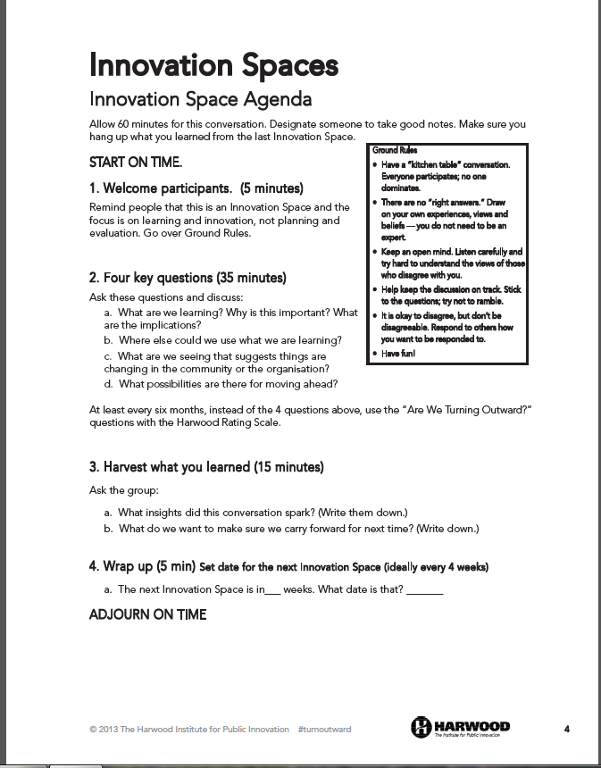
A Tool To Create A Turned Outward Learning Culture
Innovation Space
Four Questions
Two Key Steps

Slide 9
Innovation Space A Tool To Create A Turned Outward Learning Culture
Four Questions:

Slide 10
Two Key Steps
Step 1: Keep The Focus on Learning
Keep people focused on the initial questions – be firm here
What are we learning? Why is this important? What are the implications?
Have a “parking lot” chart for planning ideas
Start your first Innovation Space with a strong facilitator
Keeps the conversation flowing
Ensures that everyone is engaged
Checks time to cover all four questions

Slide 11
Two Key Steps
Step 2: Take Action with What You Learn
Harvest the most important ideas
Capture the most important insights. Write them down.
Note where learning can be applied.
Decide where the learning needs to go
Decision-makers not present?
A planning group or another standing meeting?
Where, in your sphere of influence, can you use what you’ve learned?
Assign responsibility for sharing
Hold yourself accountable for using what you learn

Slide 12
What do you make of this?
What questions does this prompt you to ask?

