Slide 1
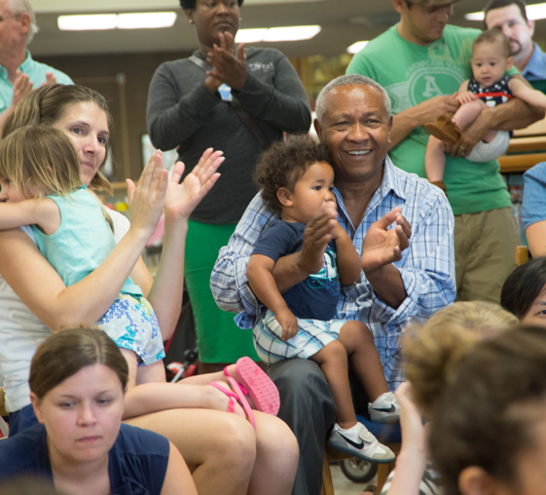
Welcome
Stay and Play: A new way to engage family, friends and neighbors who care for young children
Notes:
Slide during welcome as people arrive

Slide 2
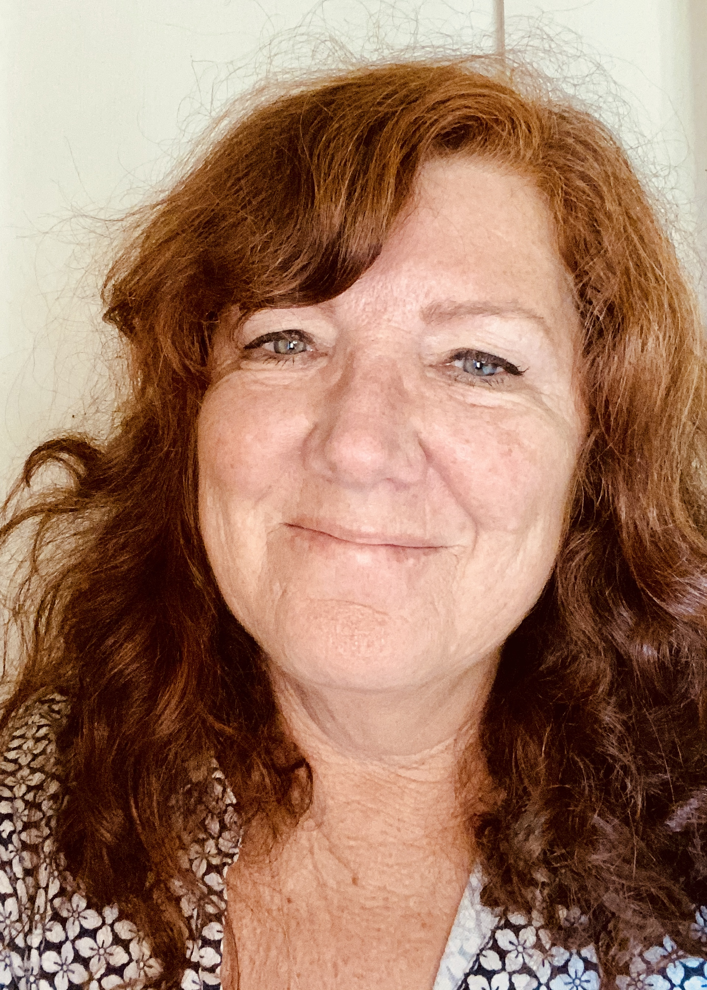
Welcome from the California State Library
Jody Thomas, Library Programs Consultant
Notes:
Jody welcomes everyone from the CA State Library
Thanks Packard
Introduces Julie as Project Manager

Slide 3
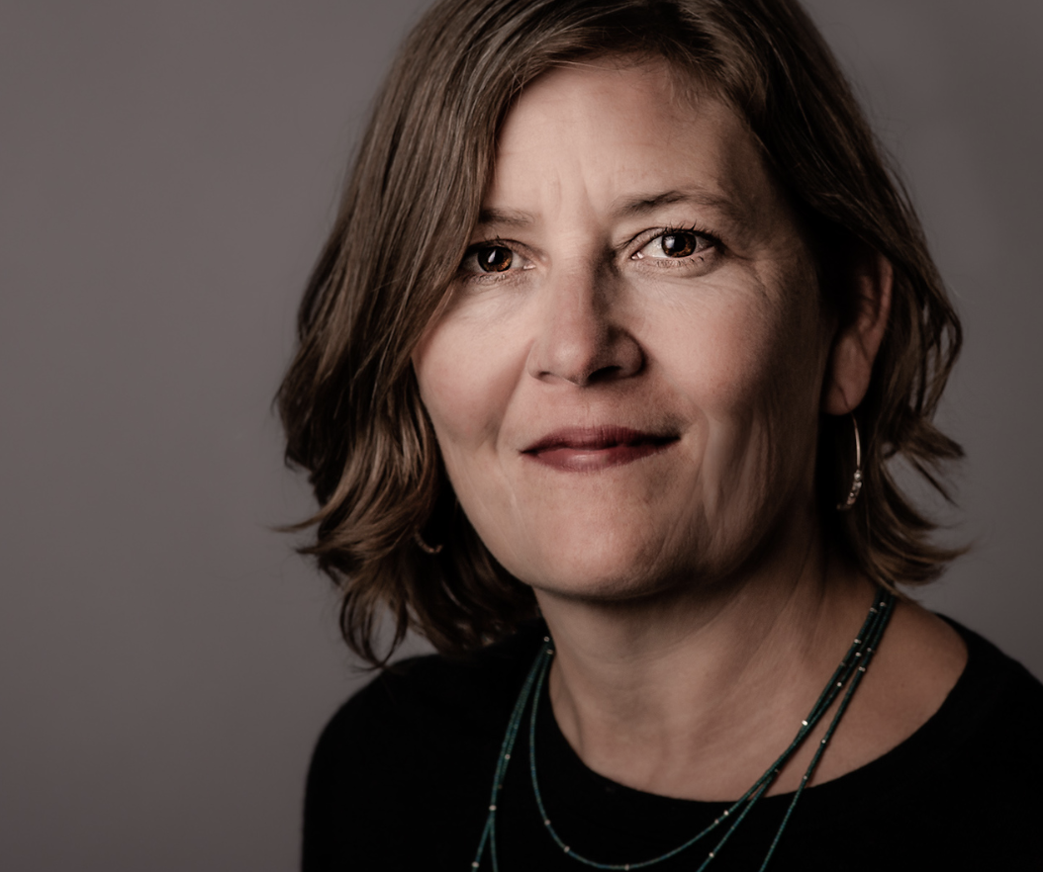
Stay & Play Pilot Project Overview
Julie Weatherston, Stay & Play Project Manager
Notes:
Julie- I’m excited to be here today to share with you some of what we learned during the Stay & Play Pilot Project. Before we dive into the case studies from two of our pilot libraries, I’d like to give you a little bit of background information.

Slide 4
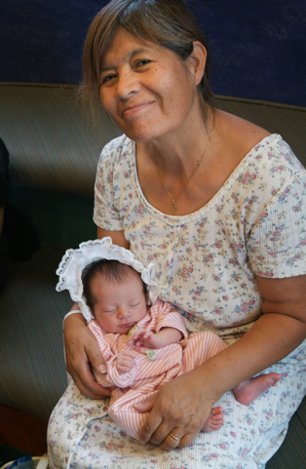
Family Friend and Neighbor (FFN):
“Anyone who cares for a child but is not a licensed provider. This group includes extended family members, friends, and neighbors (FFNs), and other adults that might receive pay or barter for providing care.”
The David and Lucile Packard Foundation, 2015. Informal Child Care in California: Current Arrangements and Future Needs.
Notes:
Julie -- I thought I would begin with defining our Stay & Play audience --- Family Friend and Neighbor caregivers of young children. FFN can be anyone who cares for a child but is not a licensed provider. This group includes extended family, friends, neighbors (FFNS) and other adults that might receive pay or barter for providing care. Sometimes FFN are also referred to as informal child care providers or “kith and kin” caregivers.
In California, roughly 80% of young children under two and 40% of children birth to five are cared for by FFN. Providing so many hours of care each week FFN have a profound impact on the lives of the children in their care. FFN often don’t have the same access to information, resources and support available to formal, licensed child care providers.
Public libraries are uniquely positioned to responsively support FFN with information, resources and community connections.
https://www.packard.org/what-were-learning/resource/informal-childcare-in-california-current-arrangements-and-future-needs/

Slide 5
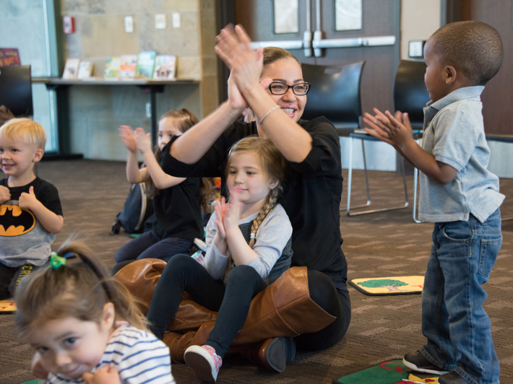
Brief Background
In 2016 Oakland Public Library received a Packard Foundation Grant to create programming specifically for FFN in their community.
The resulting Oakland Play Café led to a Pilot Grant to test this service model.
Stay and Play was the name given to the tested model that resulted.
Builds on the Early Learning with Families (ELF) Initiative.
Notes:
In 2016, the Oakland Public Library received a Packard Foundation grant to create programming specifically designed for family, friend and neighbor child care providers in their community. The resulting Oakland Play Café then led to a subsequent pilot grant to test this service model in other, diverse library settings throughout California which resulted in the service model we are sharing today called “Stay & Play” .
Stay & Play builds on early learning foundations and best practices that have been promoted, for more than a decade, by the California State Library’s Early Learning with Families (ELF) initiative – which is a statewide initiative that supports continued evolution of library services to young children, their families and caregivers.
Let’s take a look at the five components of stay and play that inform all aspects of the program…

Slide 6
Five Components of Stay and Play
Targeted and focused outreach to FFN providers
Library Storytimes specifically designed for informal caregivers and children
Play opportunities that model high quality care settings and encourage caregiver/child interactions
Programming, resource materials, and community experts to better equip caregivers with child development and early learning information
Provision of food or opportunities to accommodate the food needs of caregivers and children
Notes:
Each of the five components do not look the same in every program but they are included in every program–the components can be adapted to meet the unique needs of different libraries and the Family, Friend and Neighbor child care providers in their communities
The component are listed here:
1. intentional outreach to FFN
2. Storytimes for children with their caregivers
3. Play opportunities that encourage child and care provider interactions
4. Resources, programming and experts from the community to support caregivers with child development and learning
5. Food– either providing food or accommodating food at the library
You will have a chance to see some of the differences in two of the pilots adapted these five components in the upcoming case studies

Slide 7
Five Pilot Libraries
Fresno
Grass Valley
San Jose
Santa Barbara
Tulare
Notes:
Thanks to the David and Lucile Packard Foundation we were able to pilot 5 programs to try out this service model in a variety of communities across the state– urban suburban and rural… large and small.
The specific libraries were:
Fresno County Public Library (Mendota Branch)
Nevada County Community Library (Grass Valley Branch)
San Jose Public Library (Educational Park Branch)
Santa Barbara Public Library (Eastside Branch)
Tulare County Library (Pixley Branch)
We did one year of planning, another year of implementation (which included two 6 to 8 week series of weekly stay & play sessions) in which we gathered lessons learned. We are finishing up an online toolkit that should be available this fall to highlight best practices and lessons learned to assist other libraries in designing similar programs to engage and support FFN in their own communities.
Today we have two of the pilot program teams with us from Grass Valley and Santa Barbara to share their experiences with stay & play. As you listen to the presentations, please feel free to submit any questions you may have for the Q & A afterwards.
Without futher adoo I’d like to introduce our first team from Grass Valley…

Slide 8
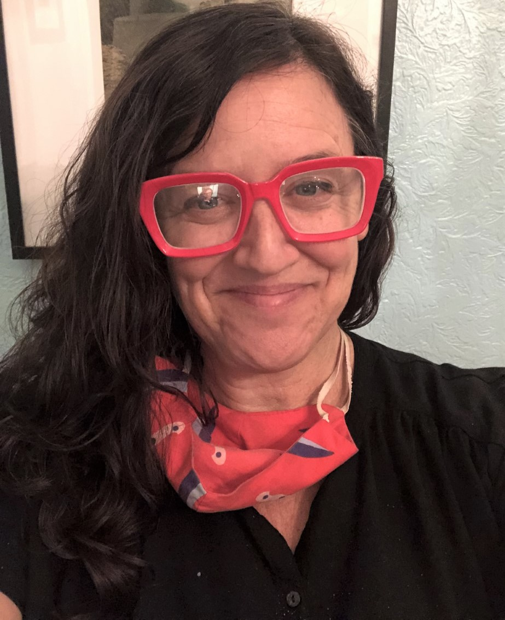
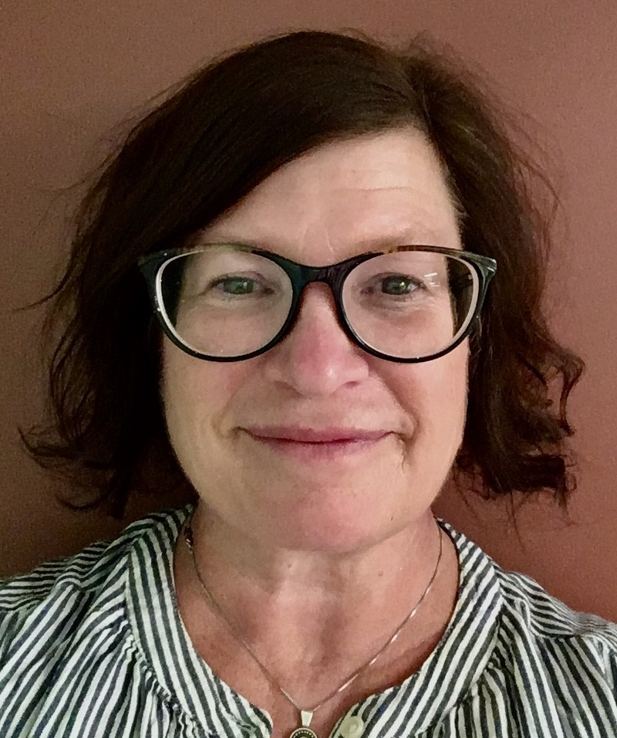
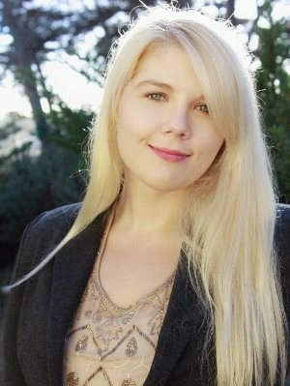
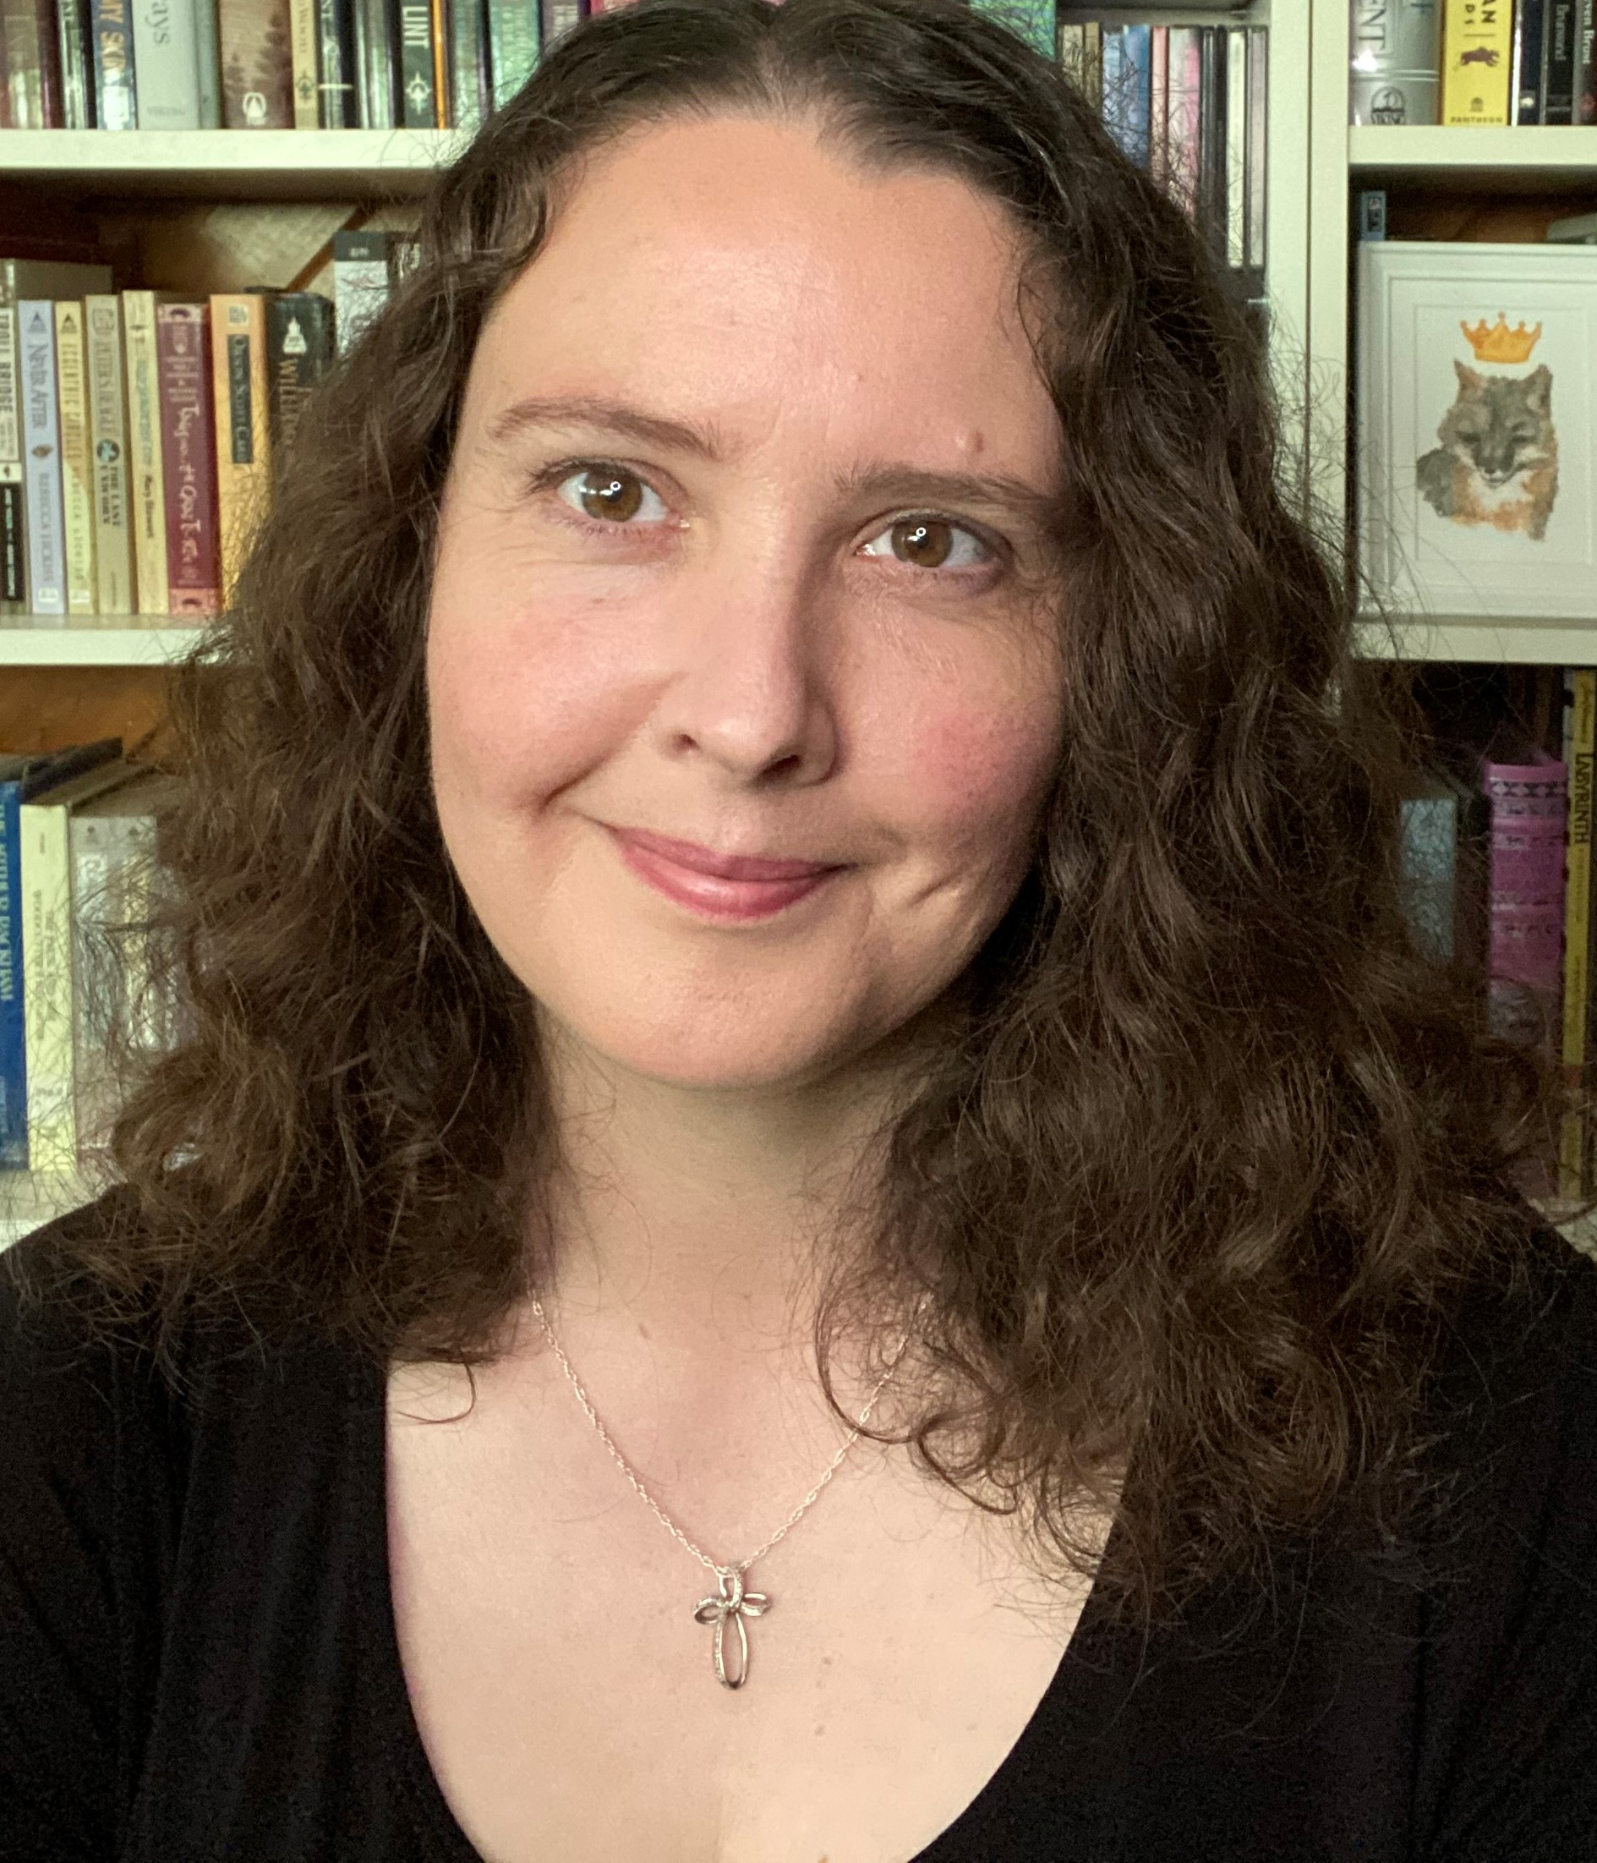
DONNA MORELLO
AMY RUTTEN
RACHEL TUCKER
MELLISA HANNUM
GRASS VALLEY LIBRARY – ROYCE BRANCH
NEVADA COUNTY COMMUNITY LIBRARY

Slide 9
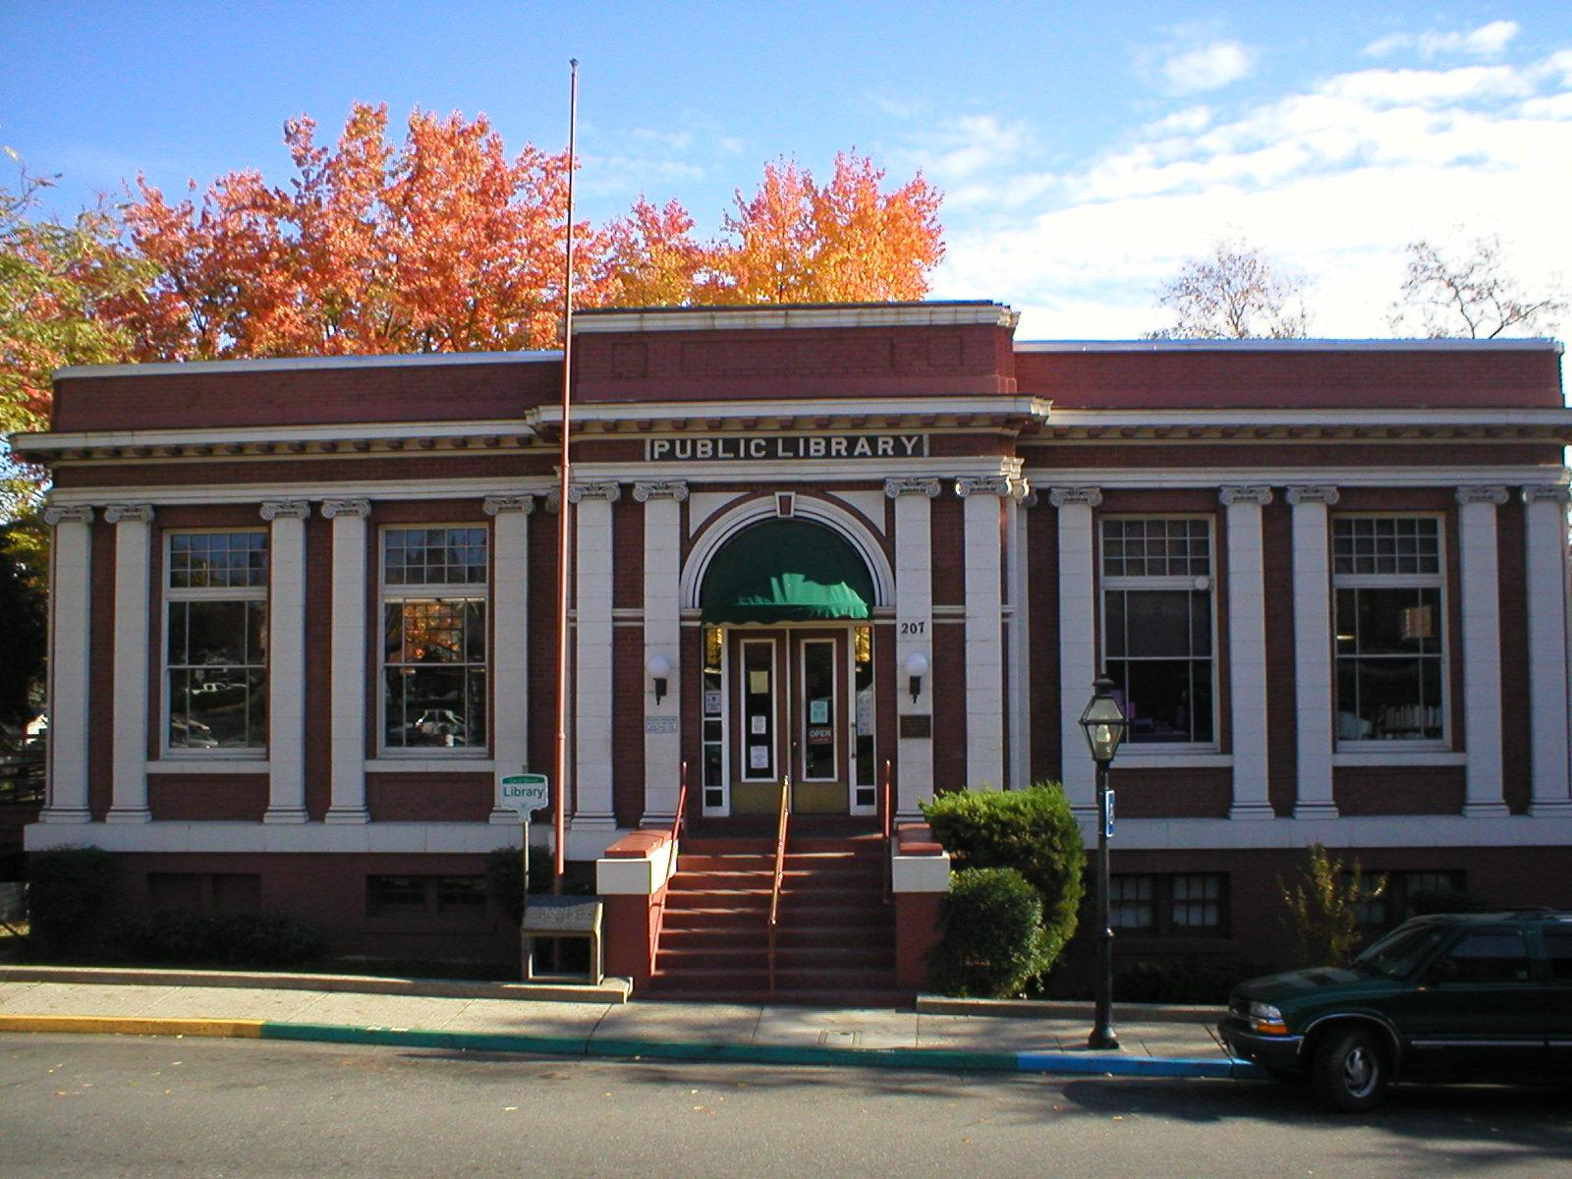
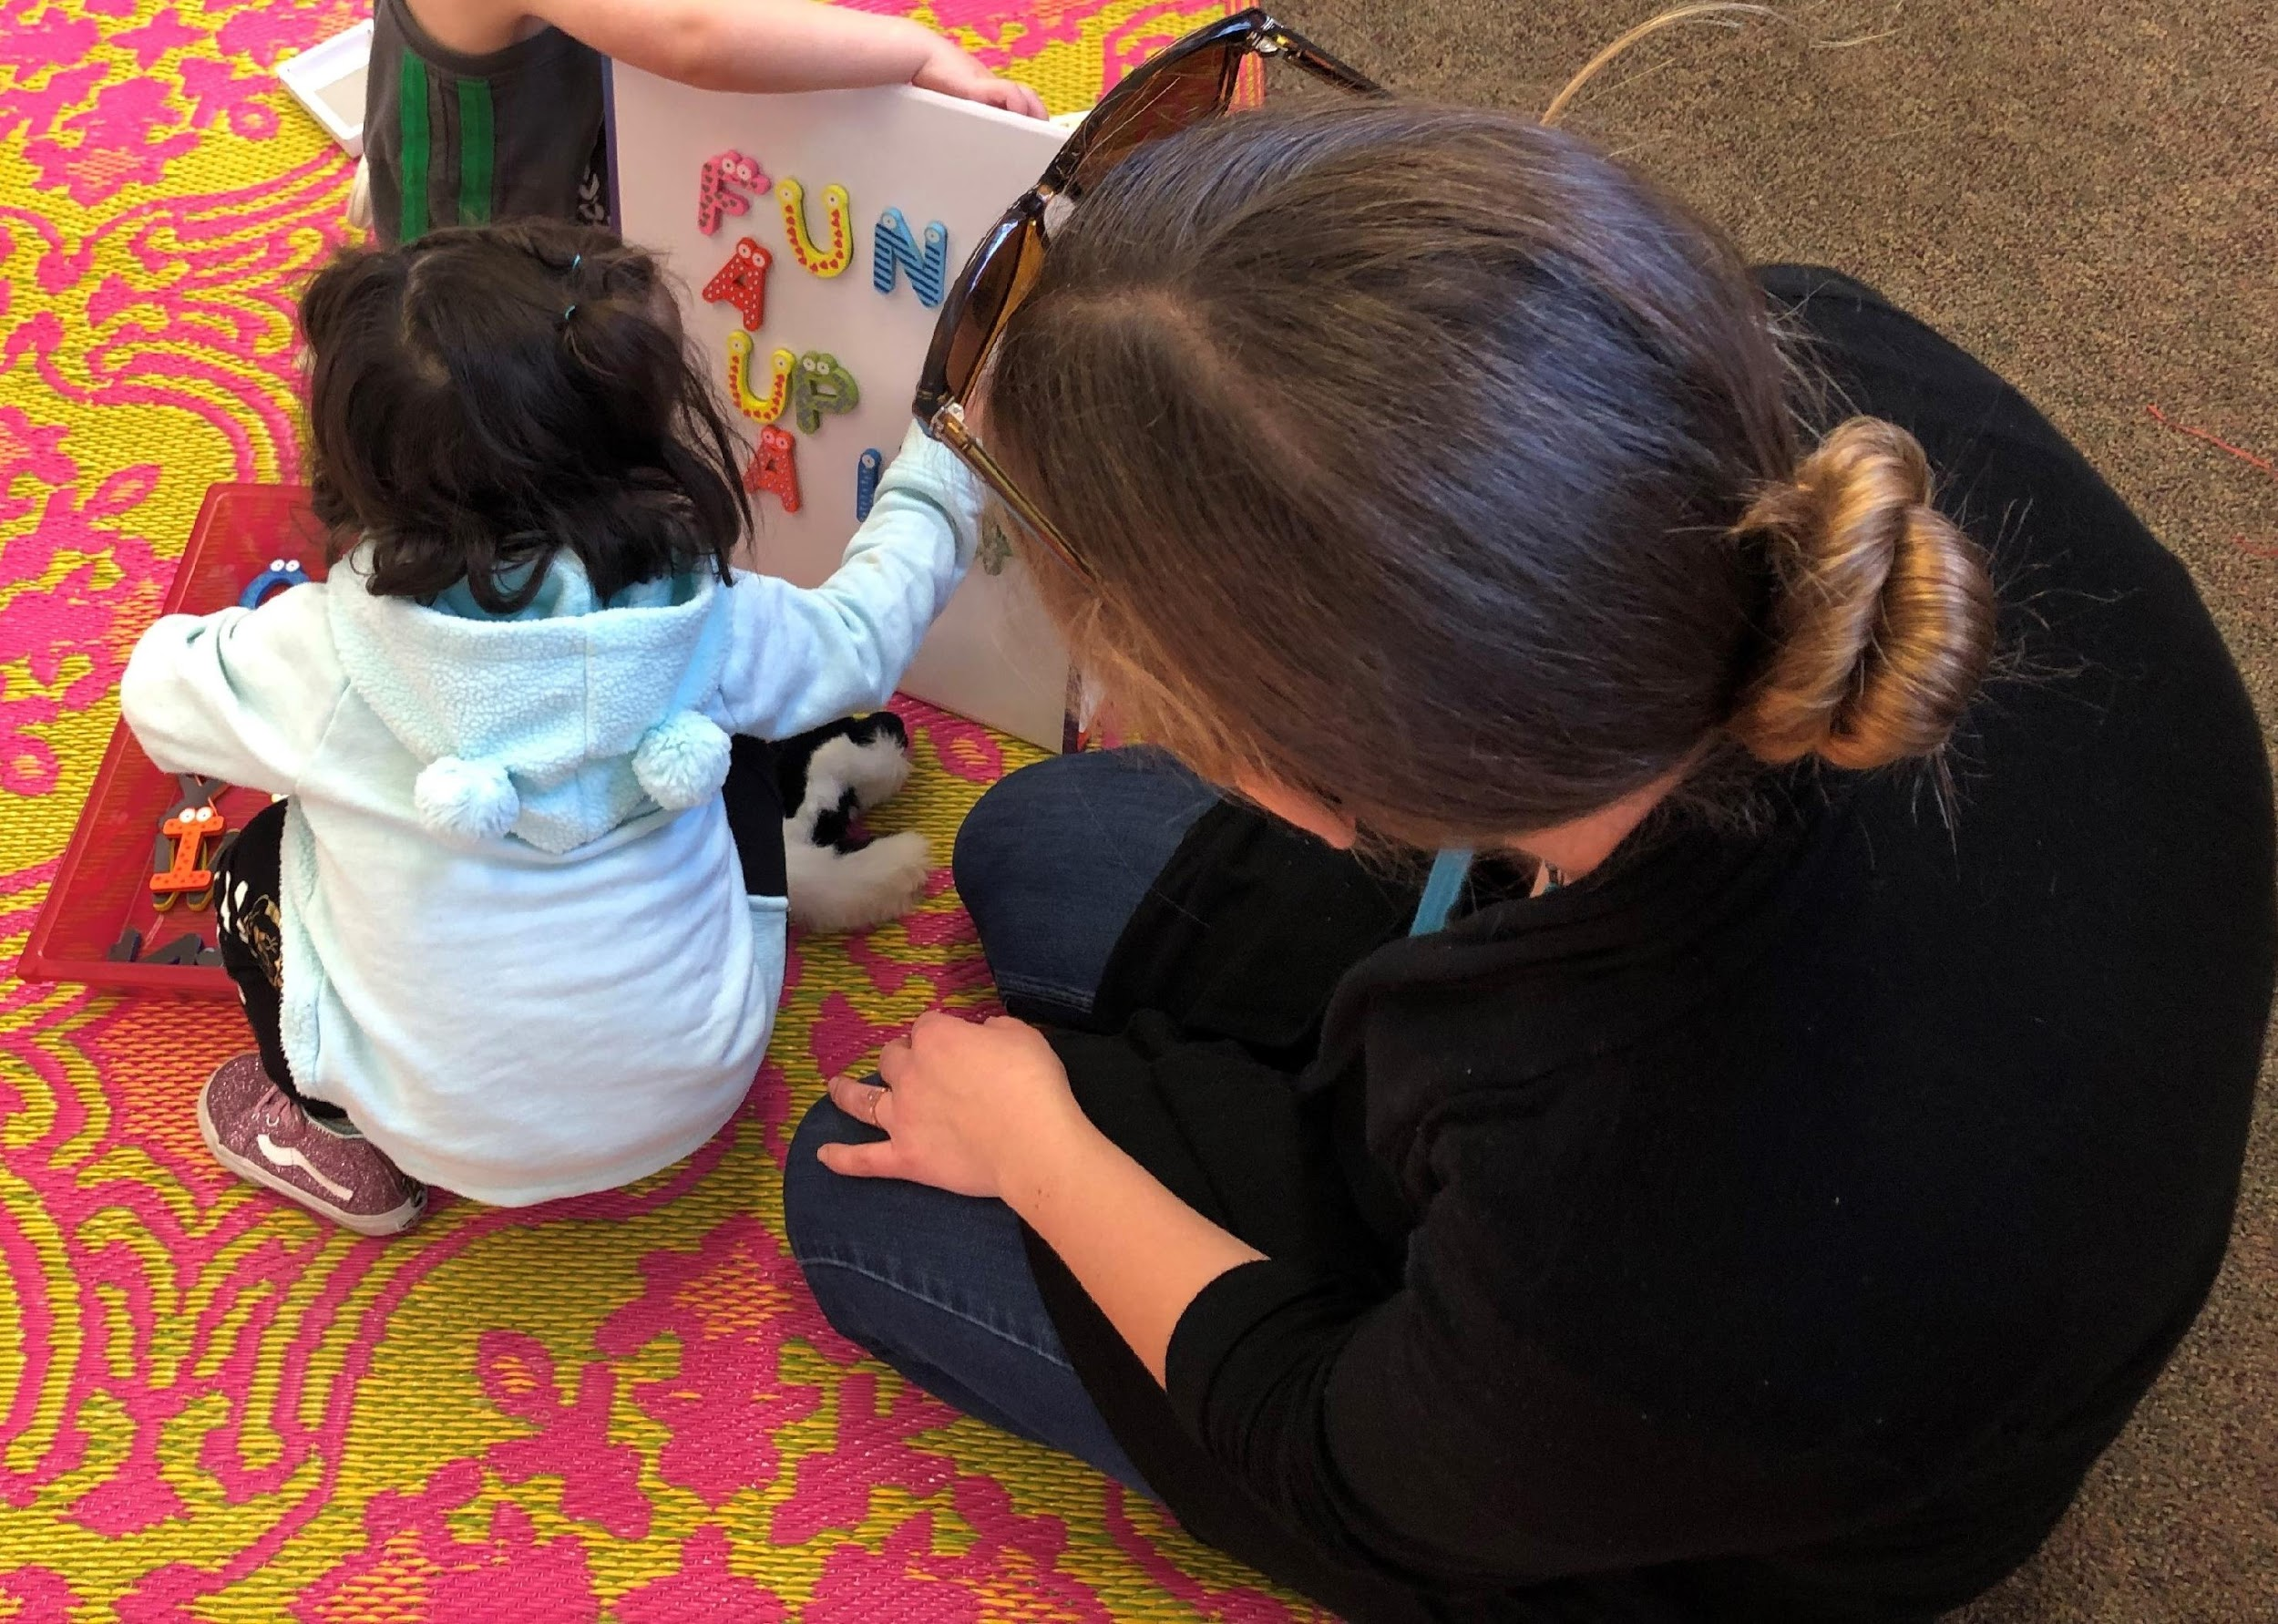
Why Stay and Play?

Slide 10
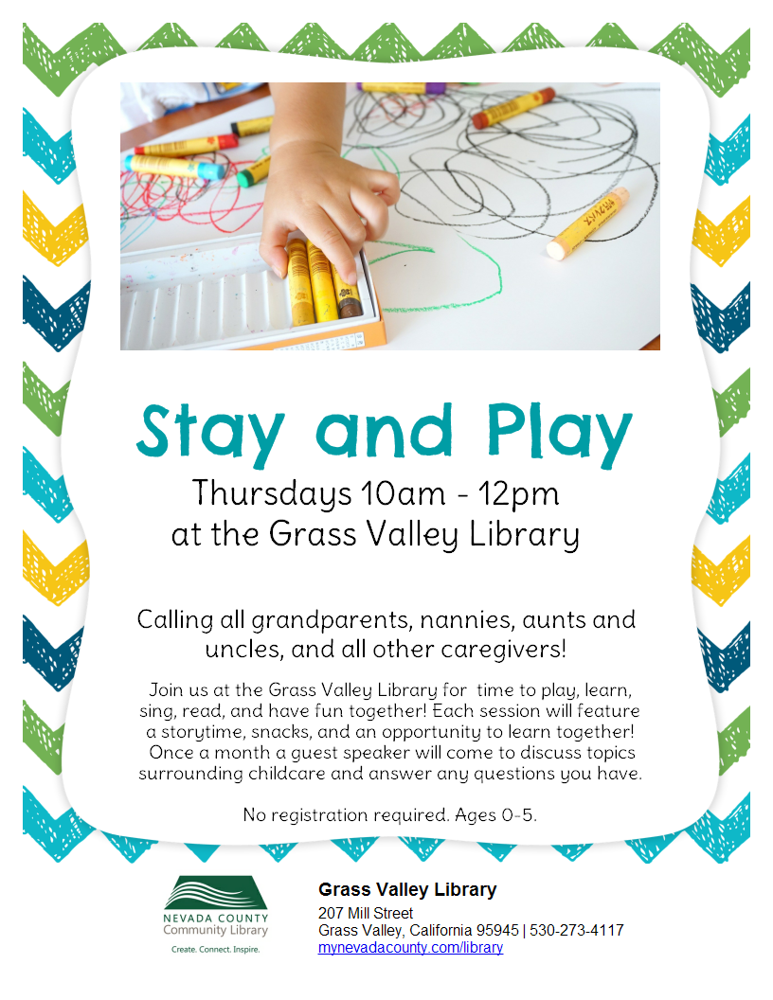
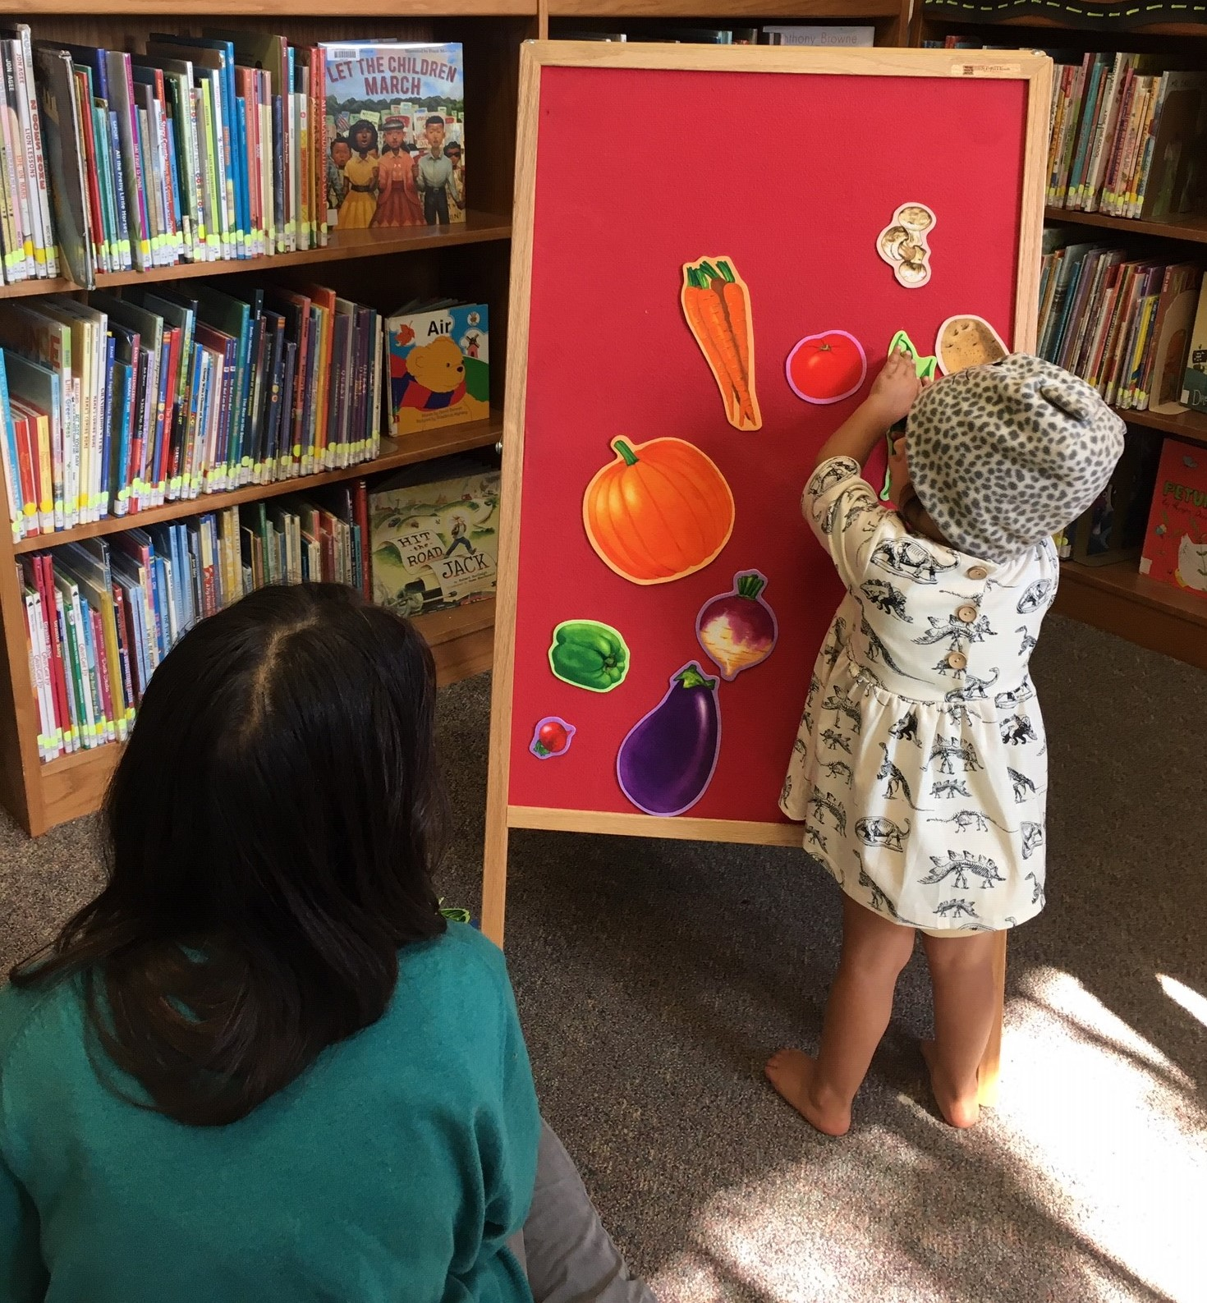
OUTREACH

Slide 11
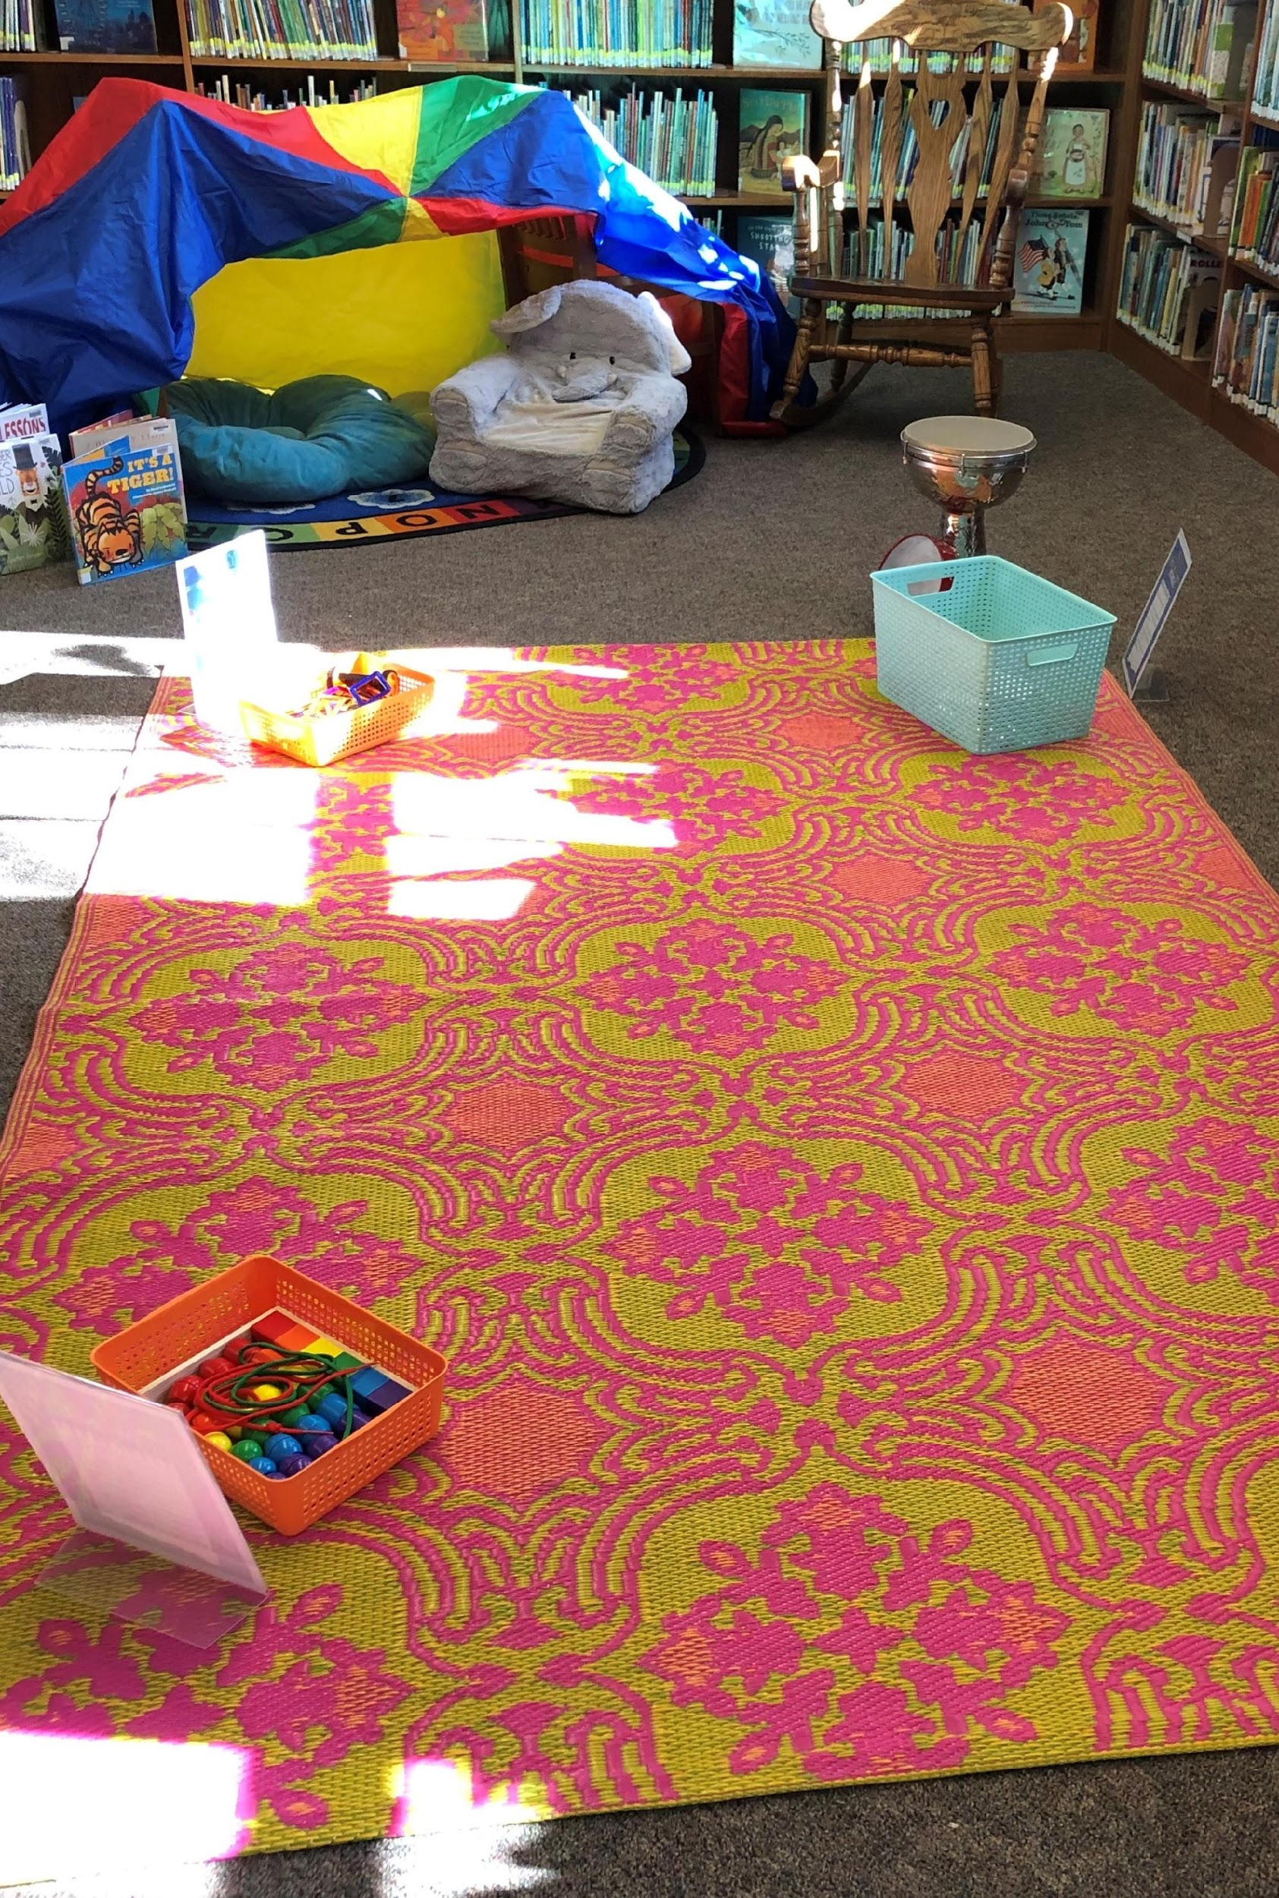
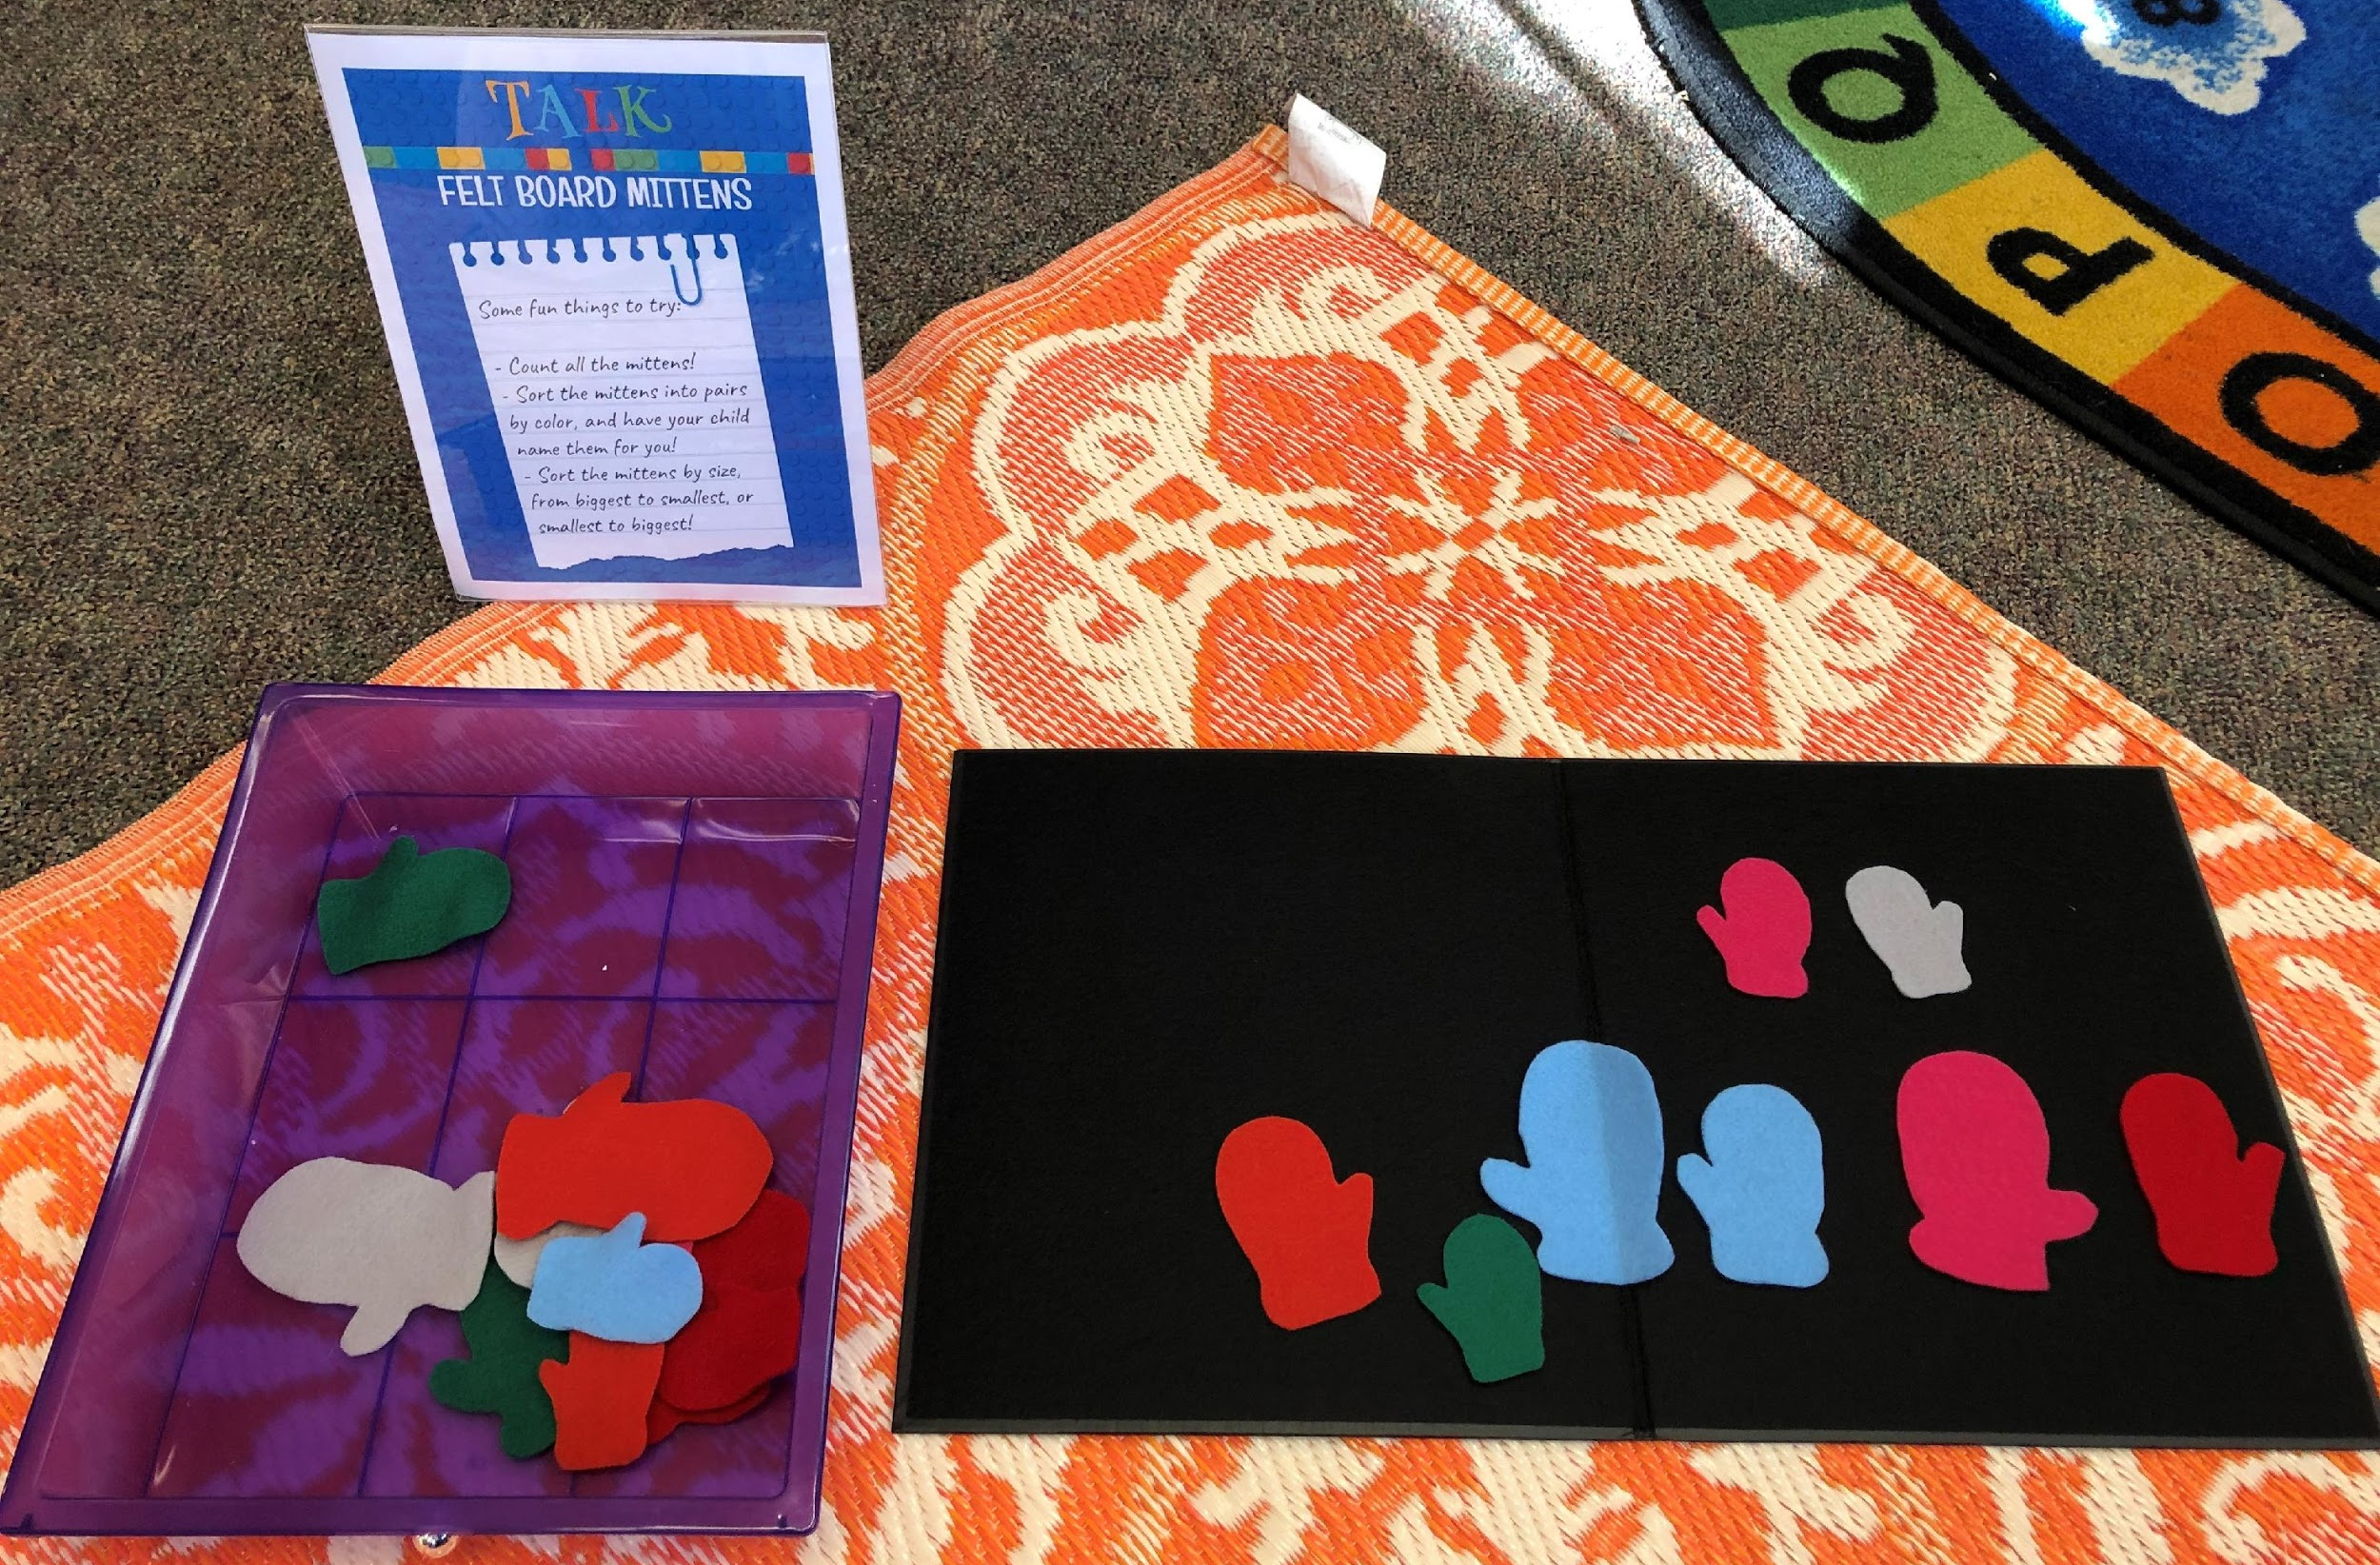
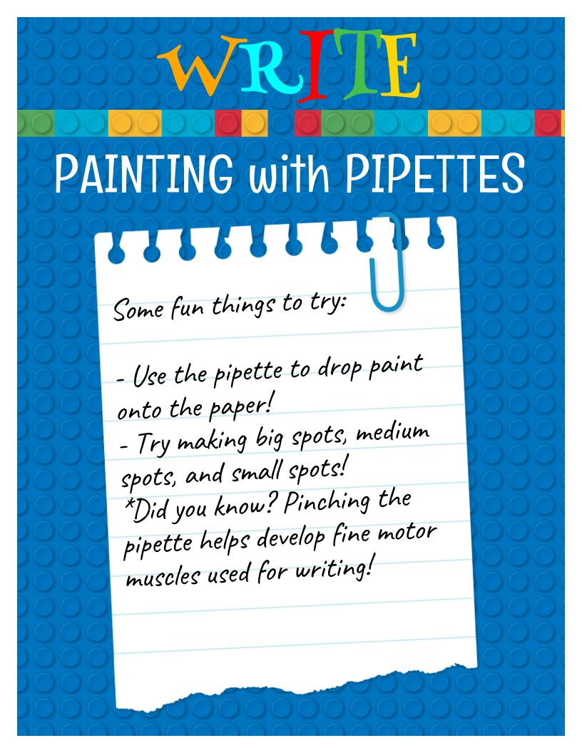
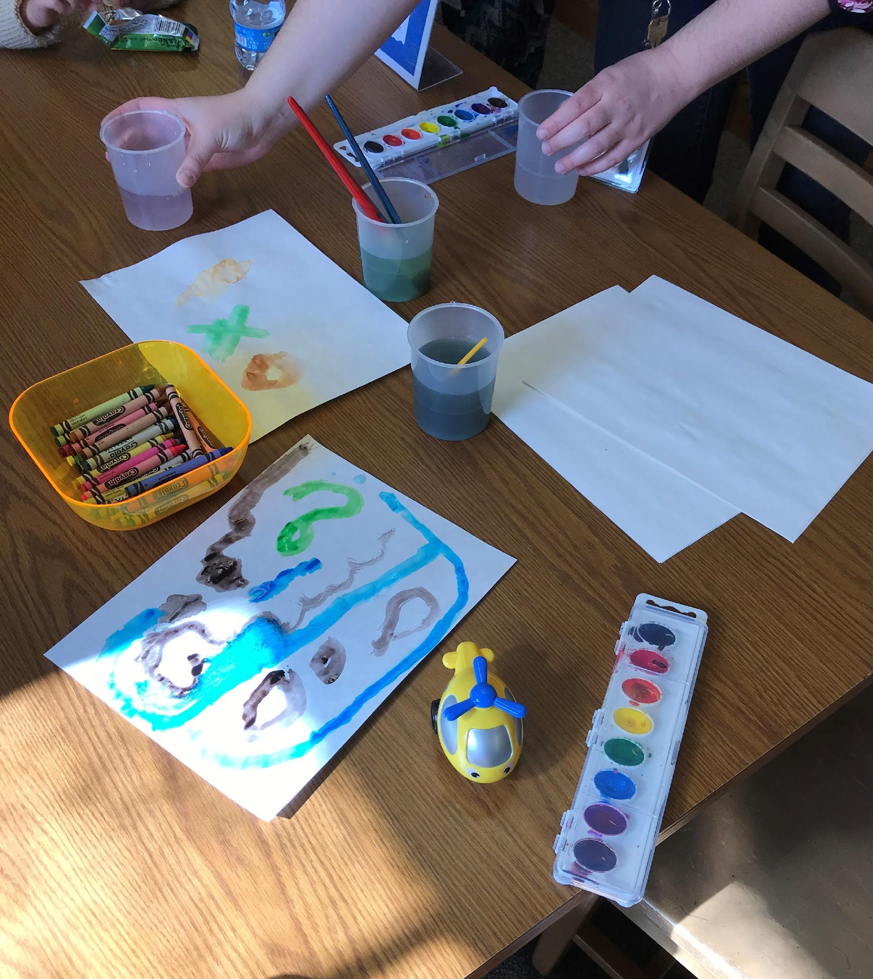
Developing the Space

Slide 12
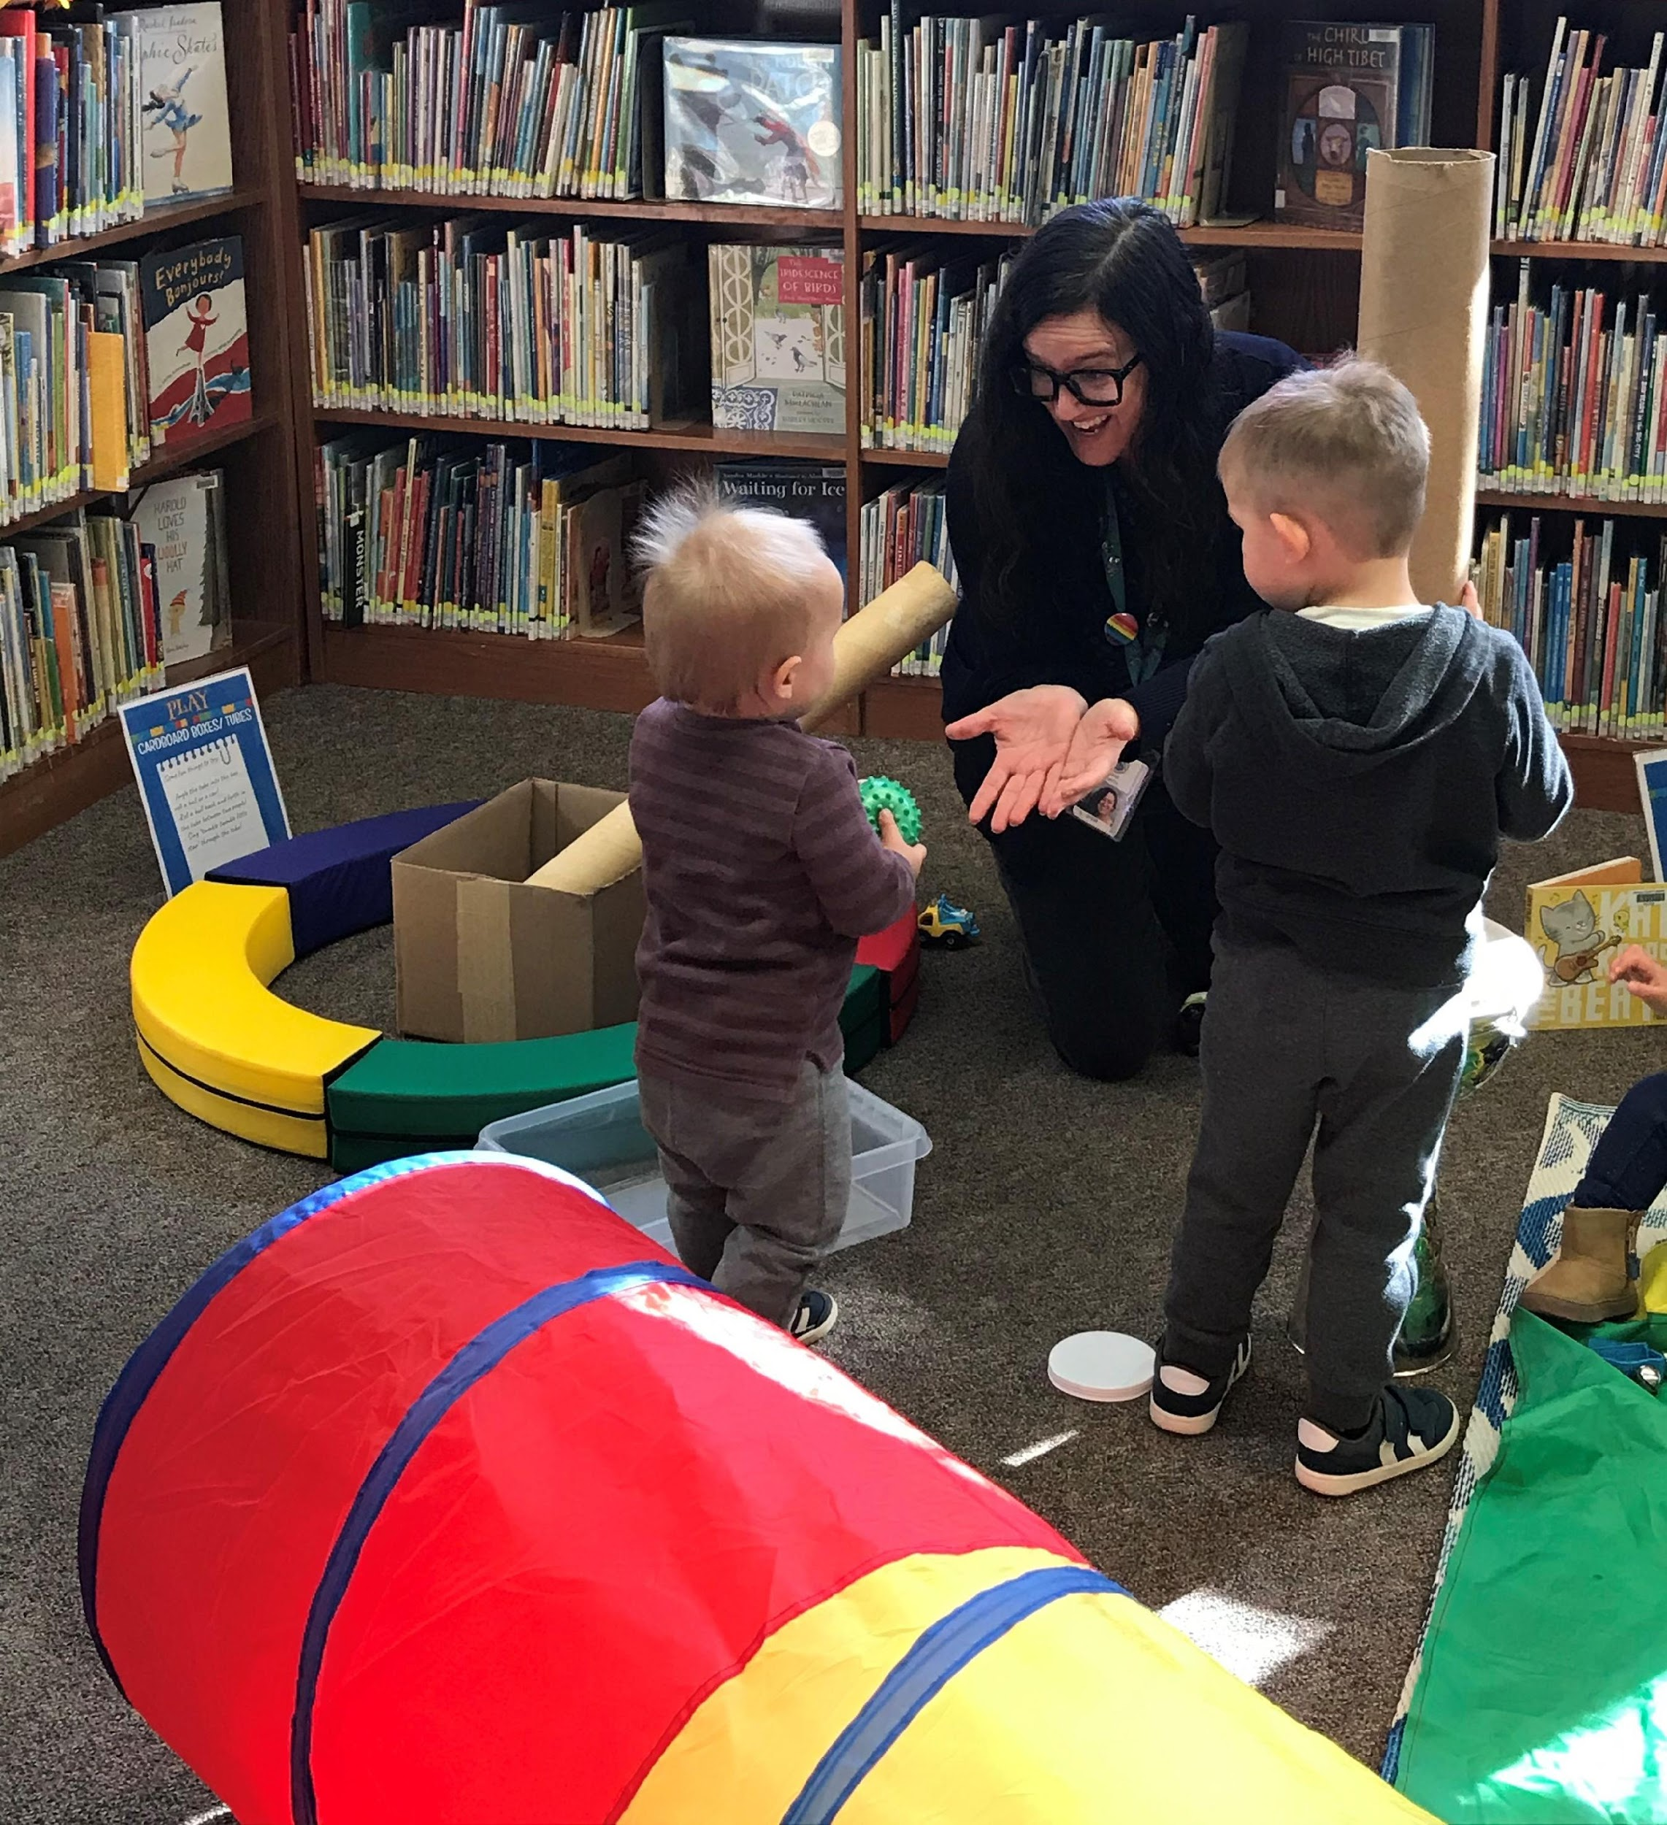
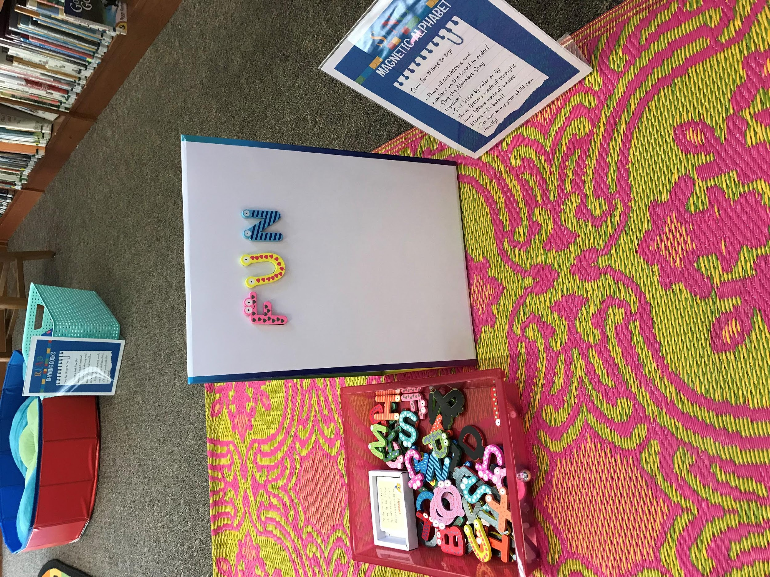
How the Five Early Literacy Practices Influence Setup

Slide 13
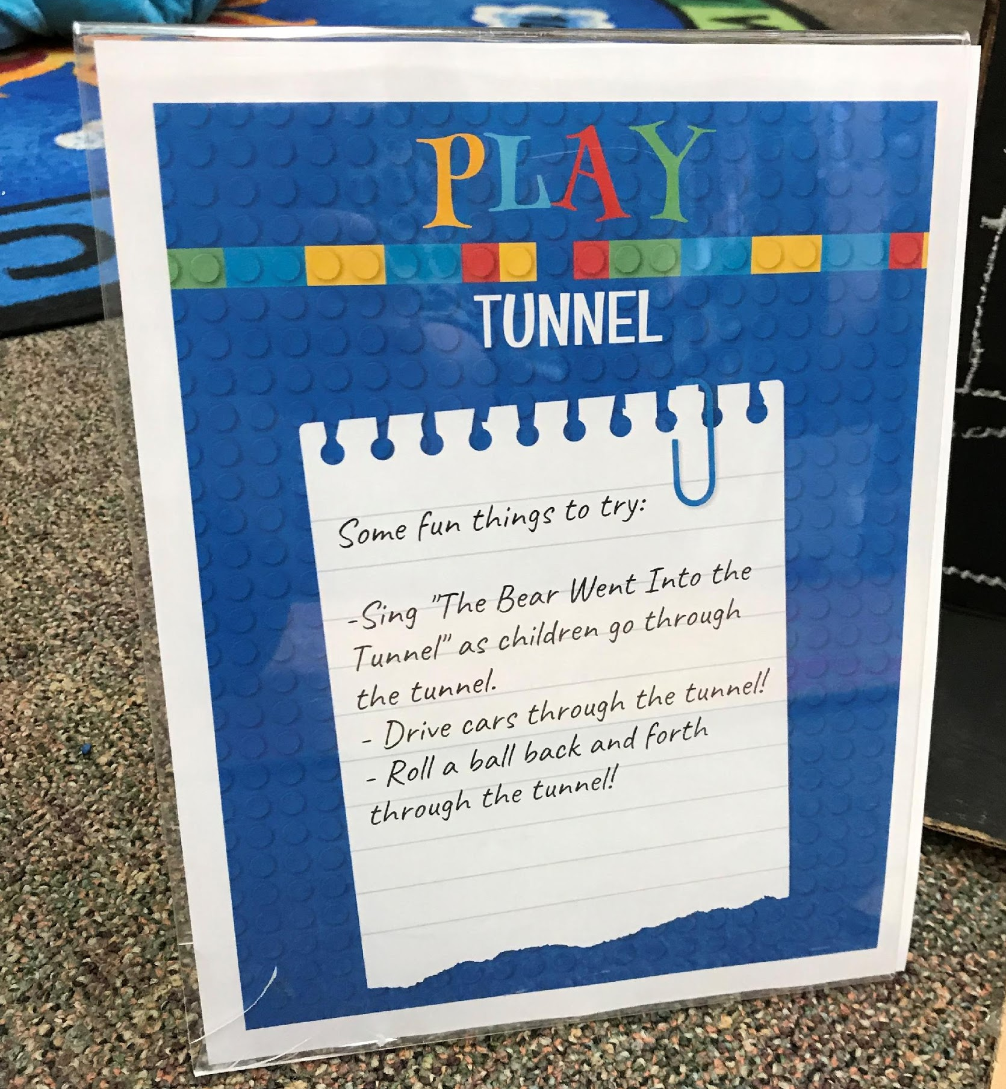
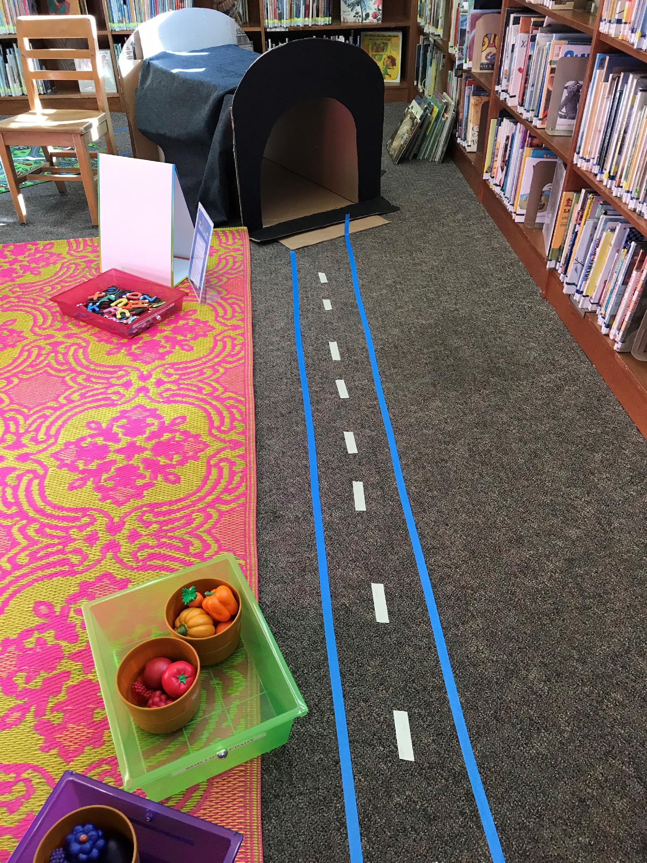
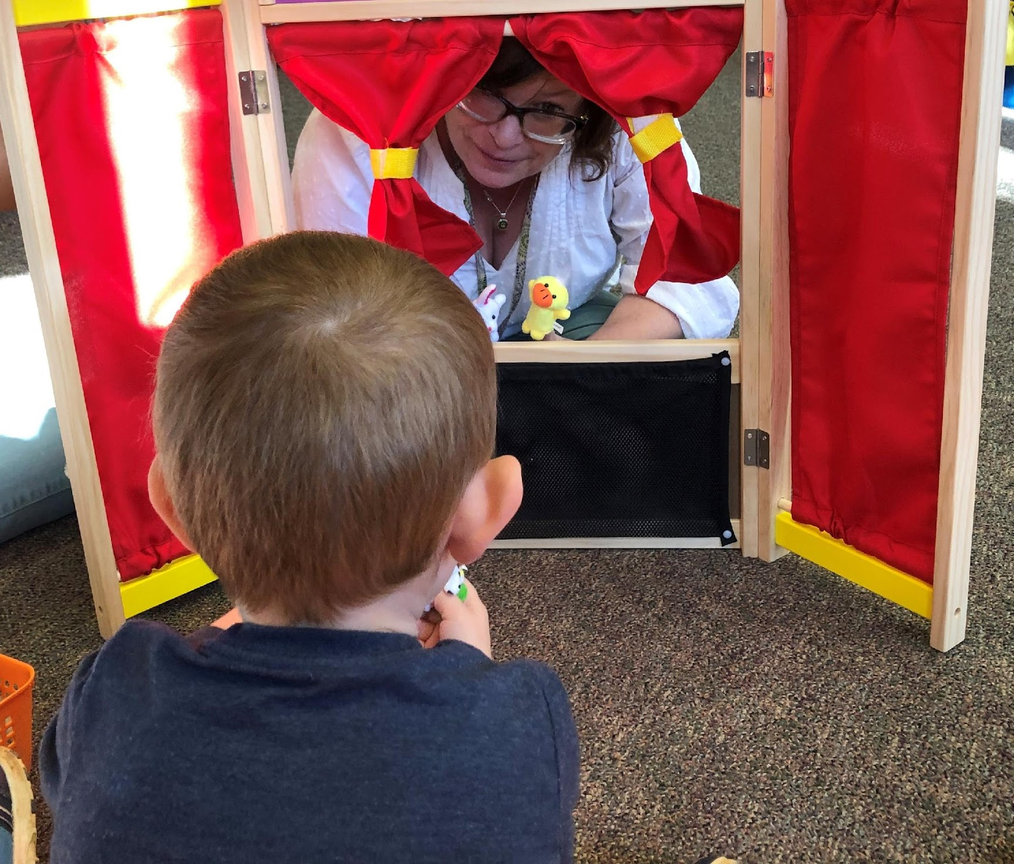
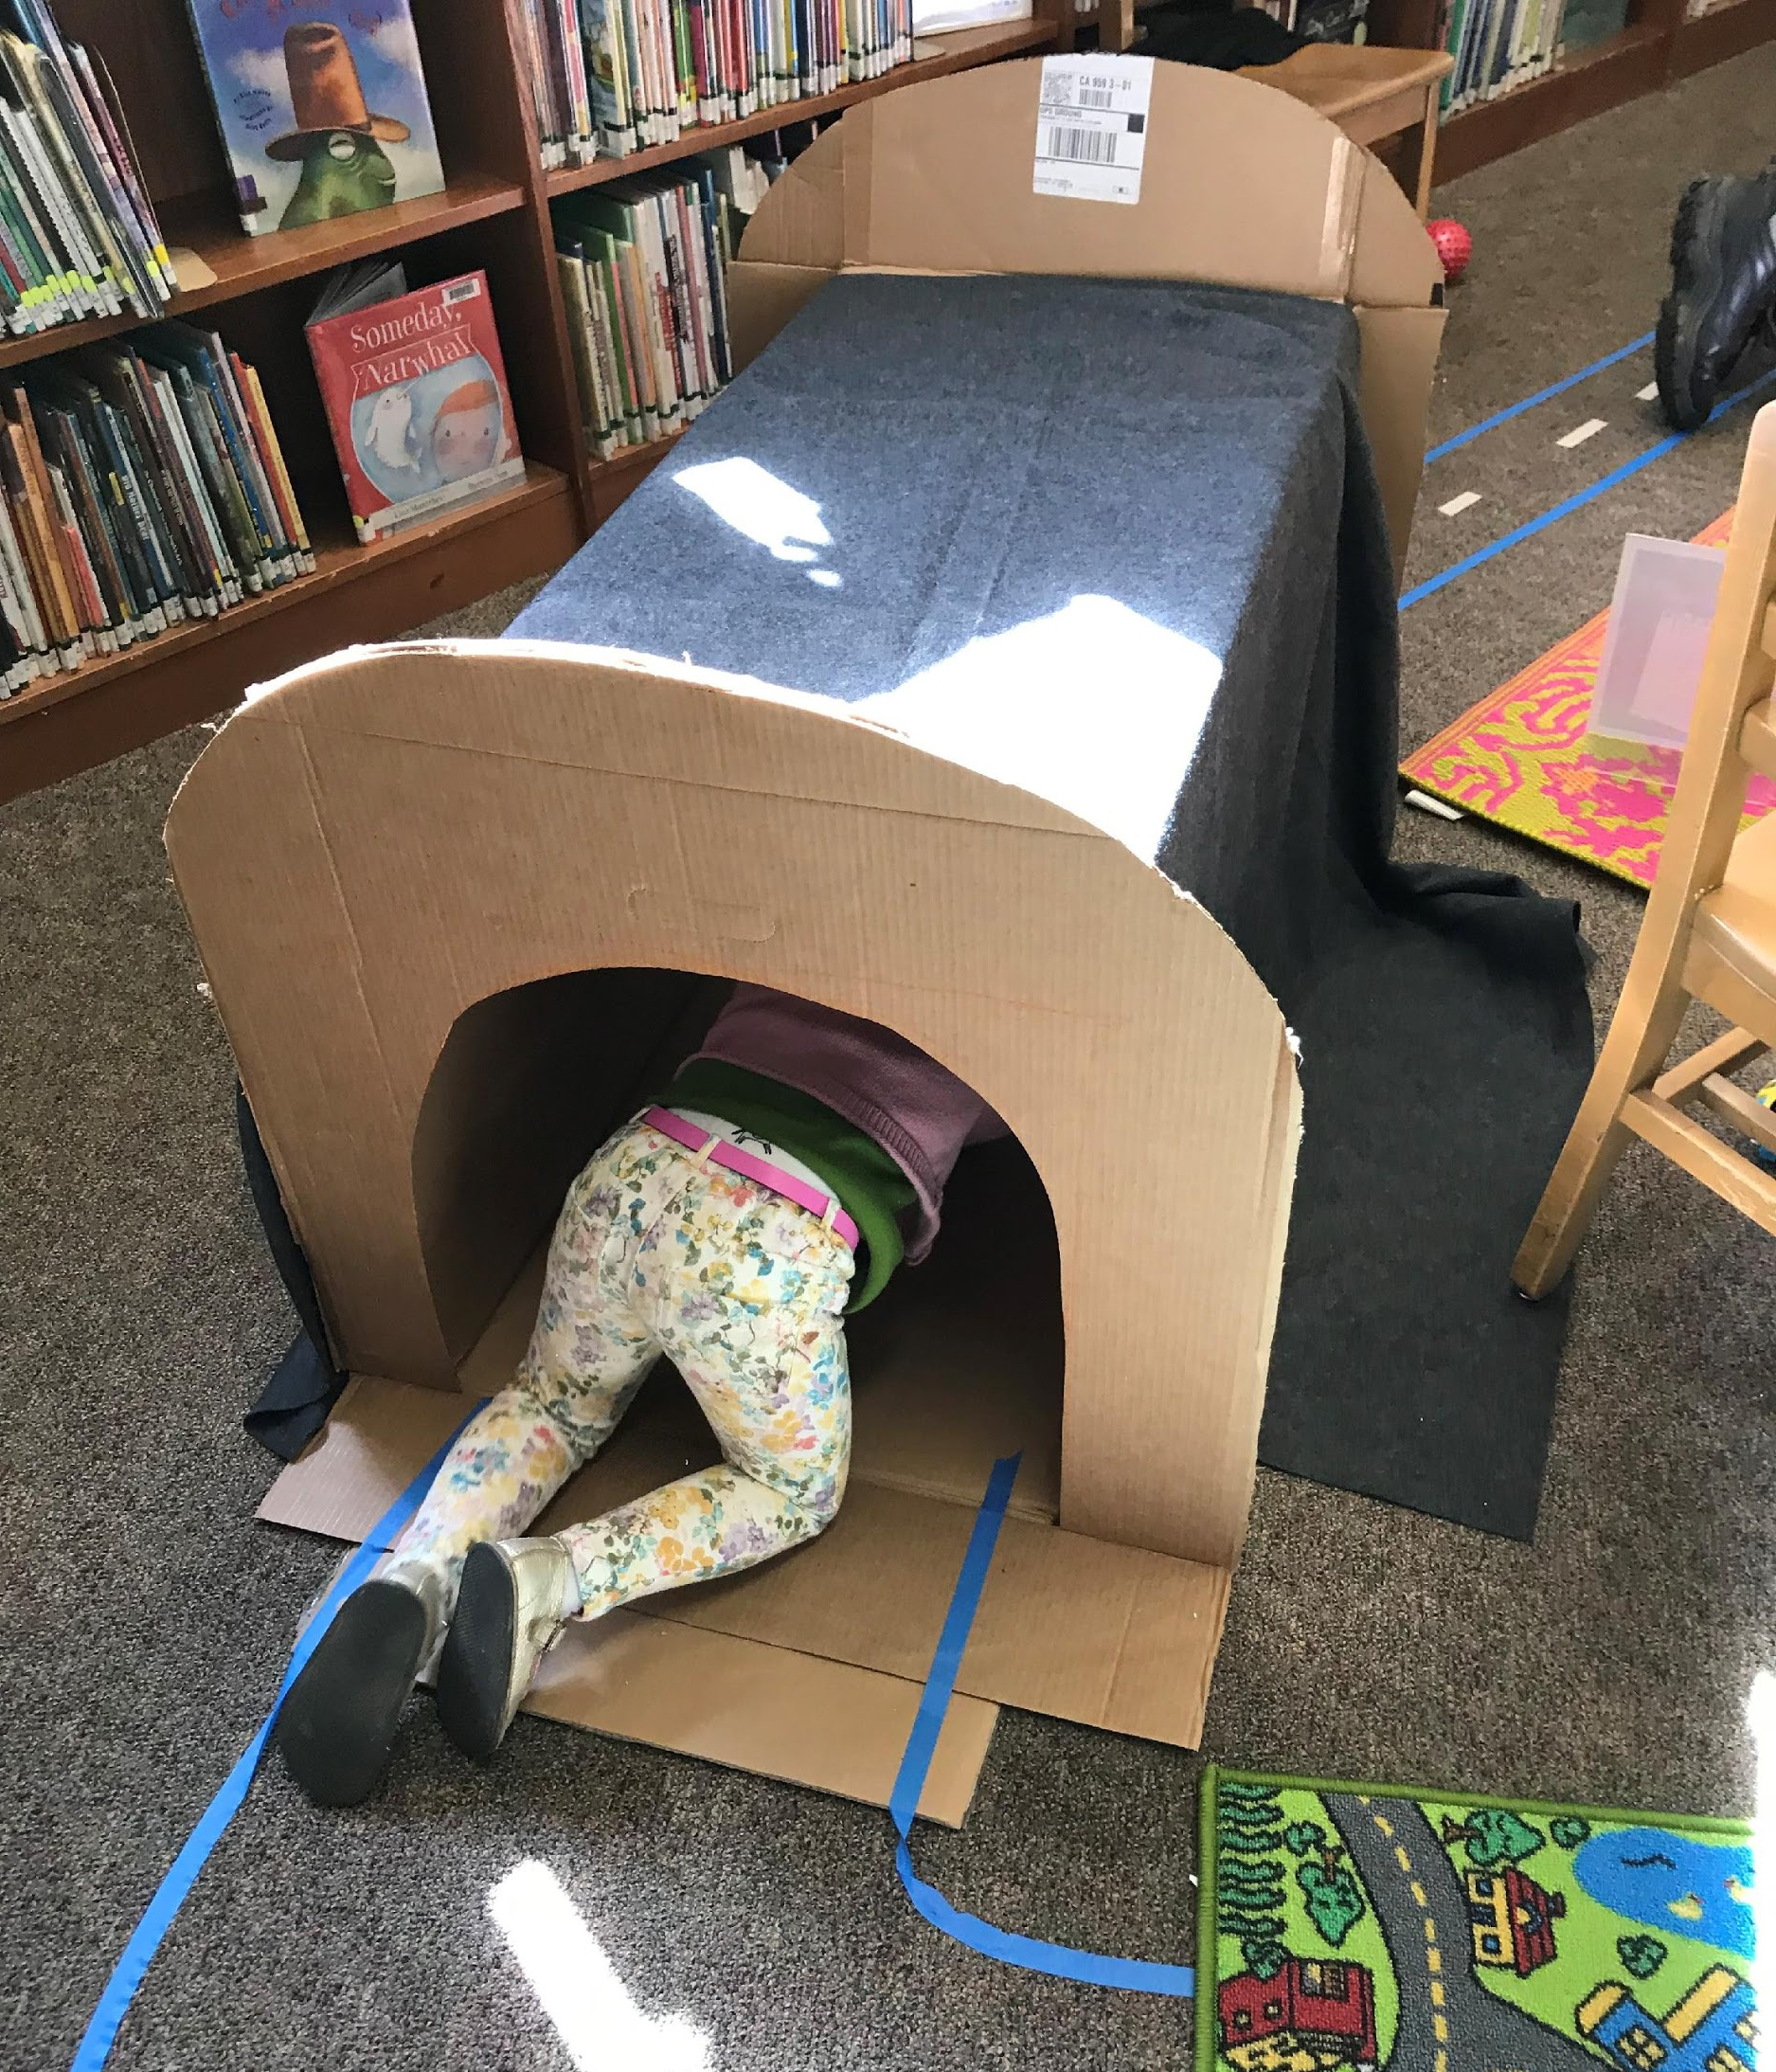
Creating a Community Space Different from a Regular Storytime

Slide 14
Time-Lapse Video

Slide 15
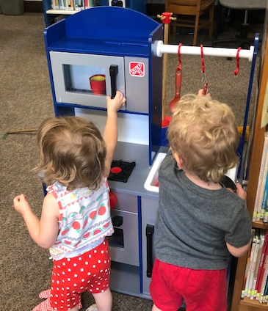
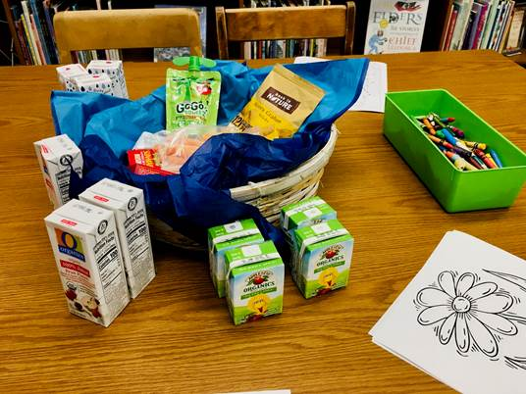
SNACKS!
Why we do it the way we do.

Slide 16
Modeling Caregiver Interaction
Two grandmothers come as strangers, and leave as friends, trading info and taking selfies to show their kids (parents of children attending) that they had made friends at the library today.
Grandmother said it was her “favorite day.”
The child in my care doesn’t “have any other opportunities to socialize with kids, so this is perfect!”

Slide 17
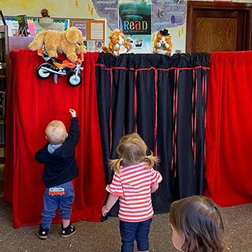
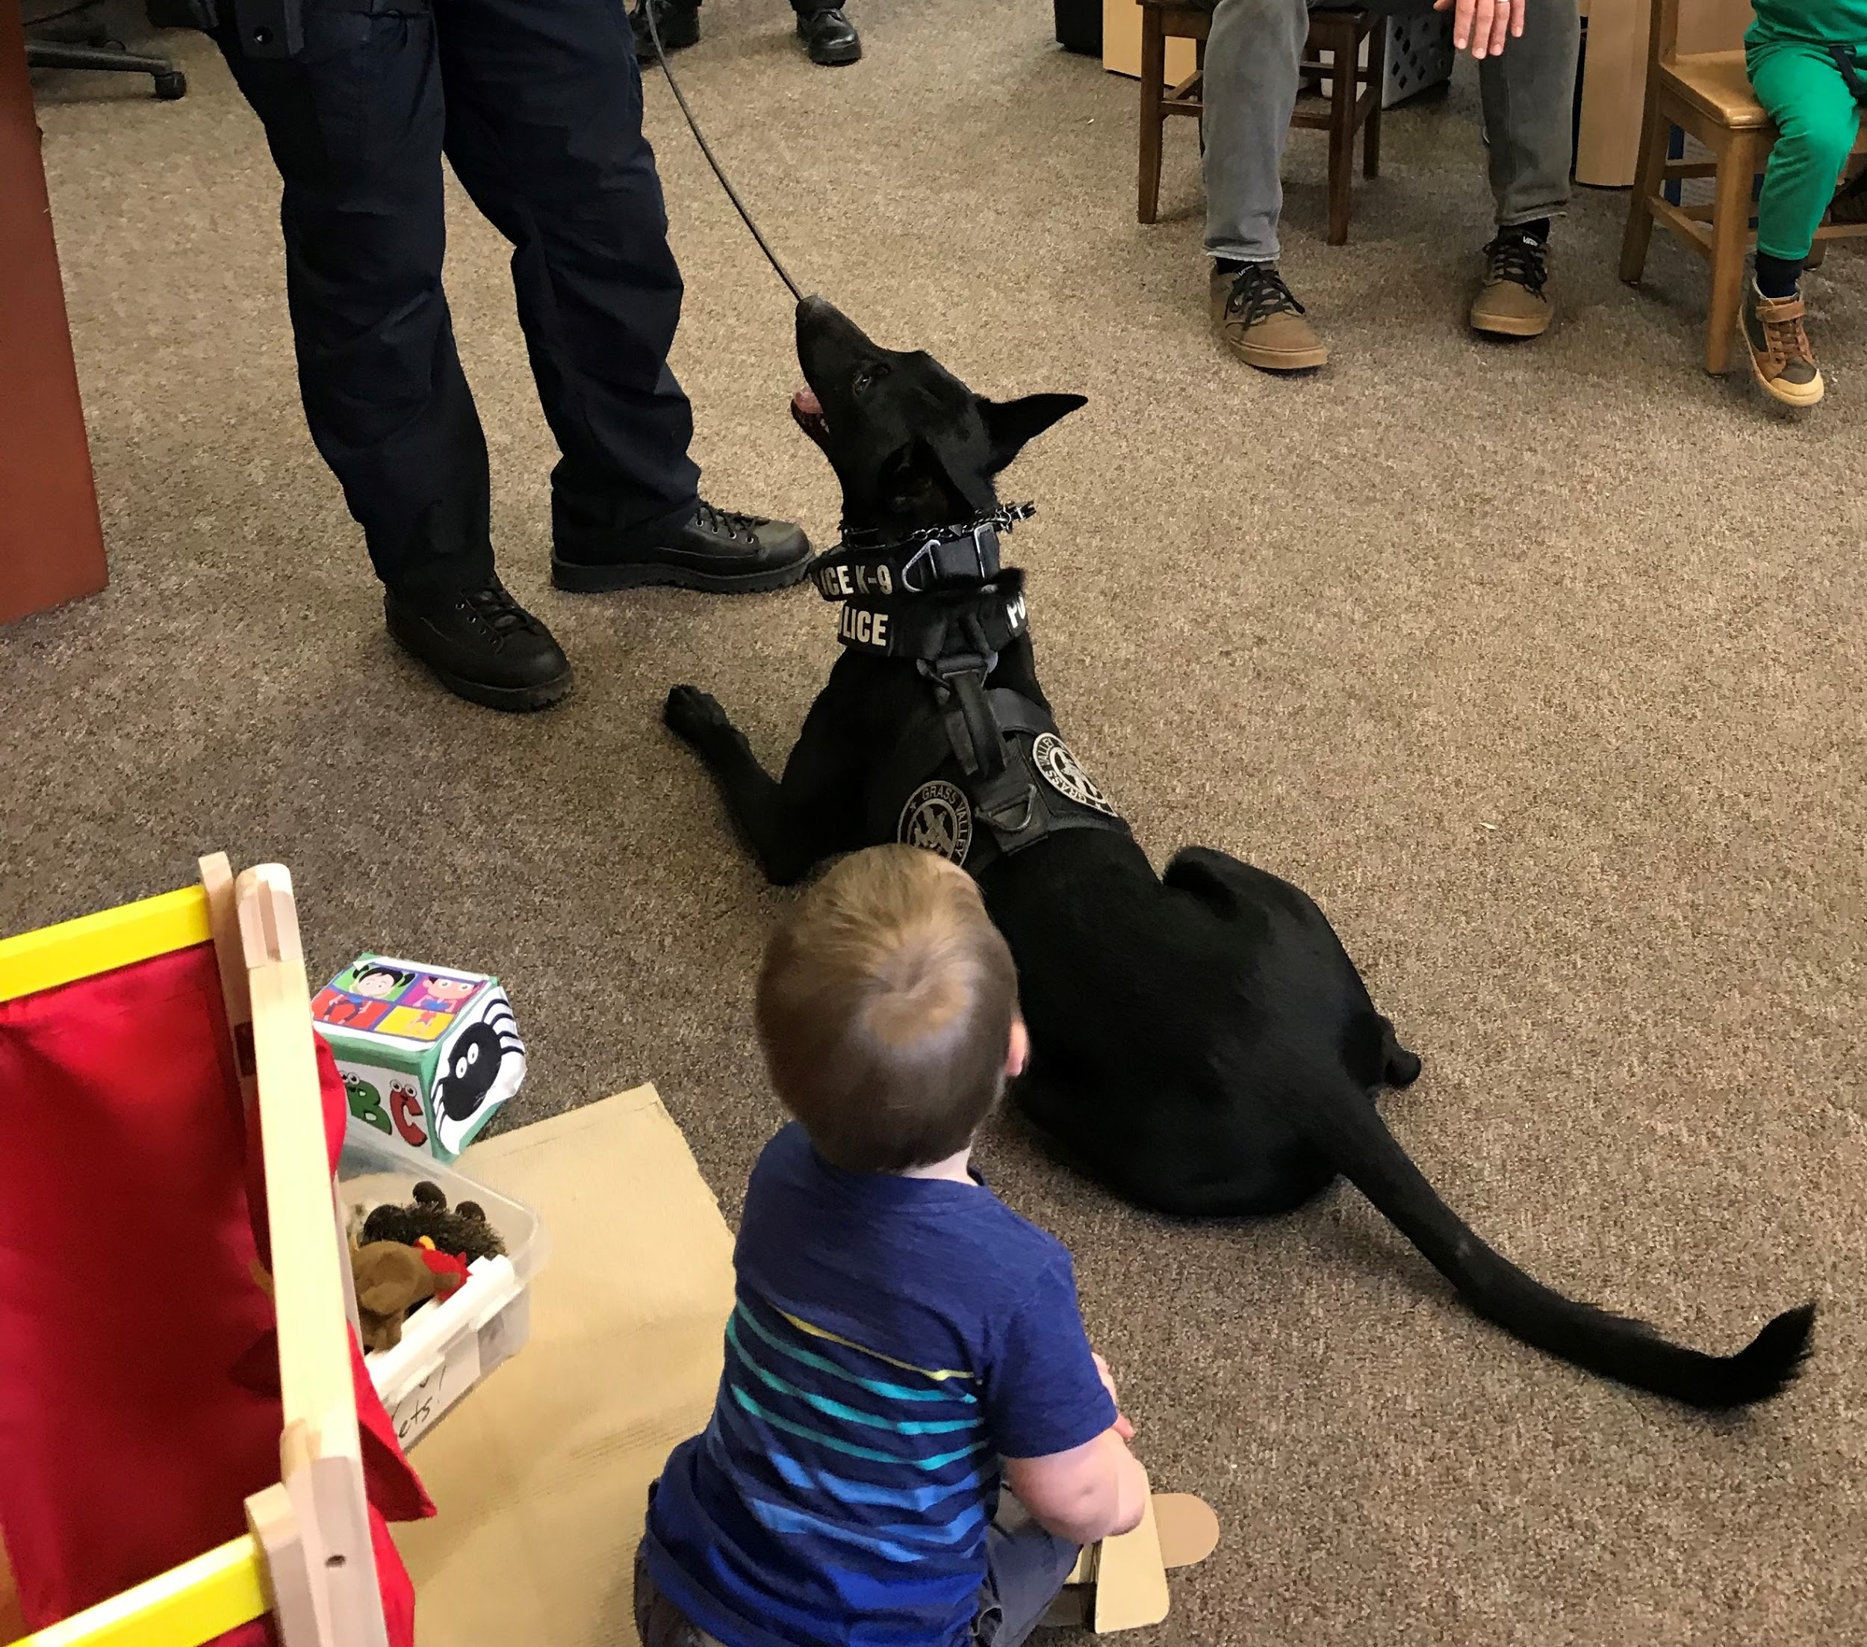
Community Partners
Sierra Nevada Children’s Services
FIRST 5 Nevada County
Public Health
2-1-1
Office of Emergency Services
Grass Valley Police Department K-9
Child Advocates of Nevada County
Child Safety Puppeteers

Slide 18
Stay and Play Eastside Branch Santa Barbara Public Library
Gwen Wagy
Cristal Gavilanes

Slide 19
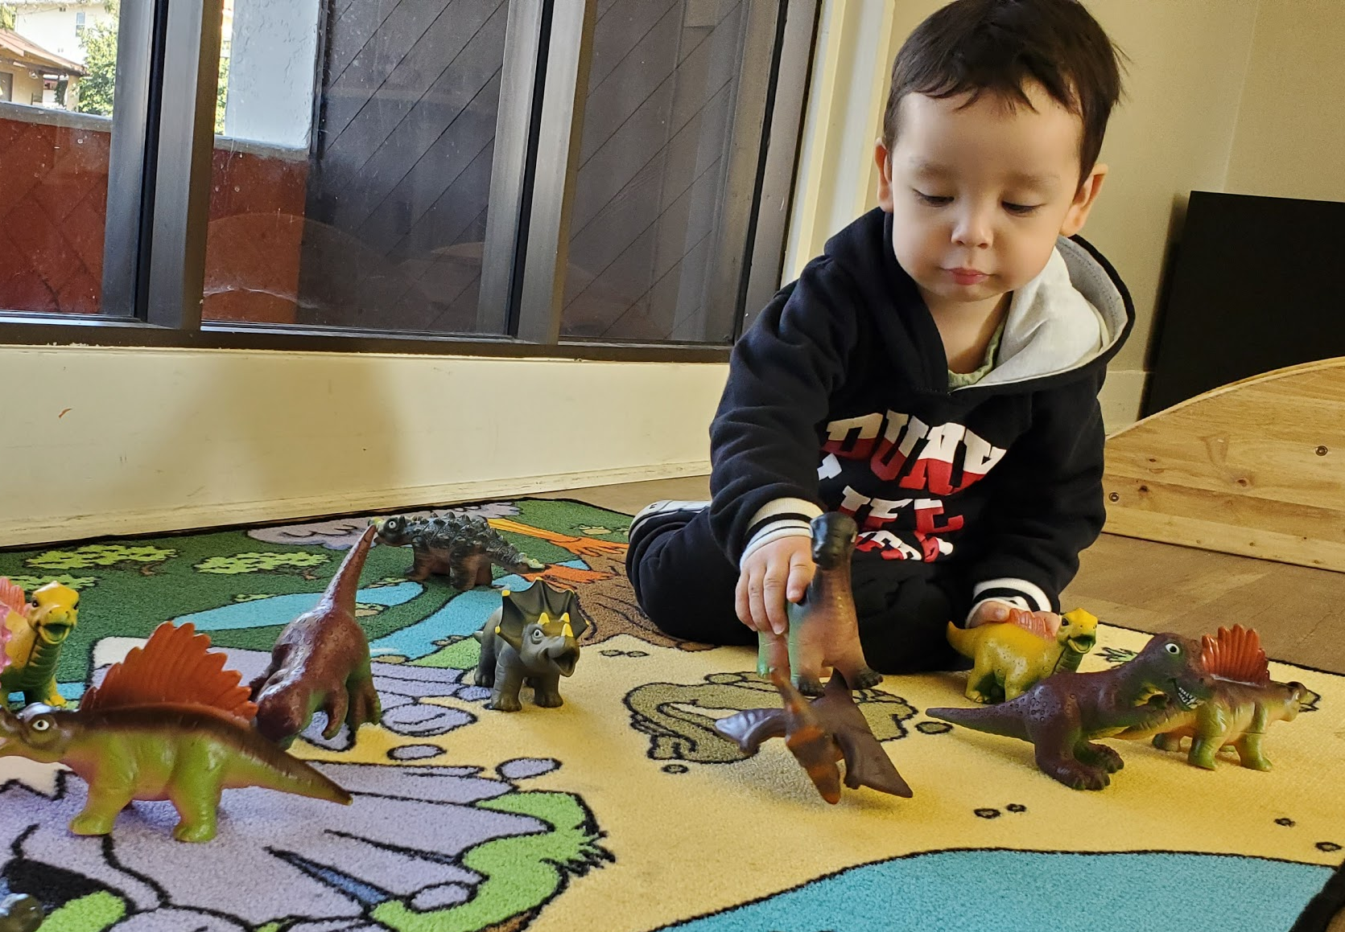
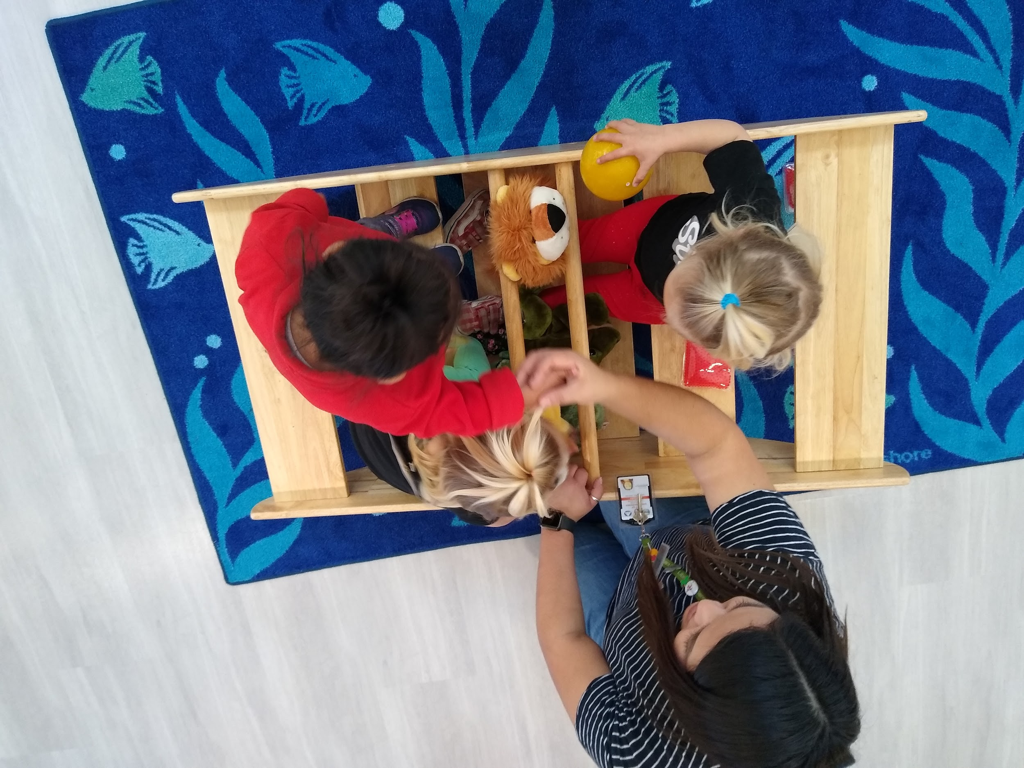

Slide 20
How Is Stay & Play Different
From Traditional Library Storytime?
Flexible start time before Library opens
No stress about being “right on time” with toddlers.
Lowered caregiver concern about “making too much noise in the Library.”
Allowed for parent / caregiver drop-off & exchange.

Slide 21
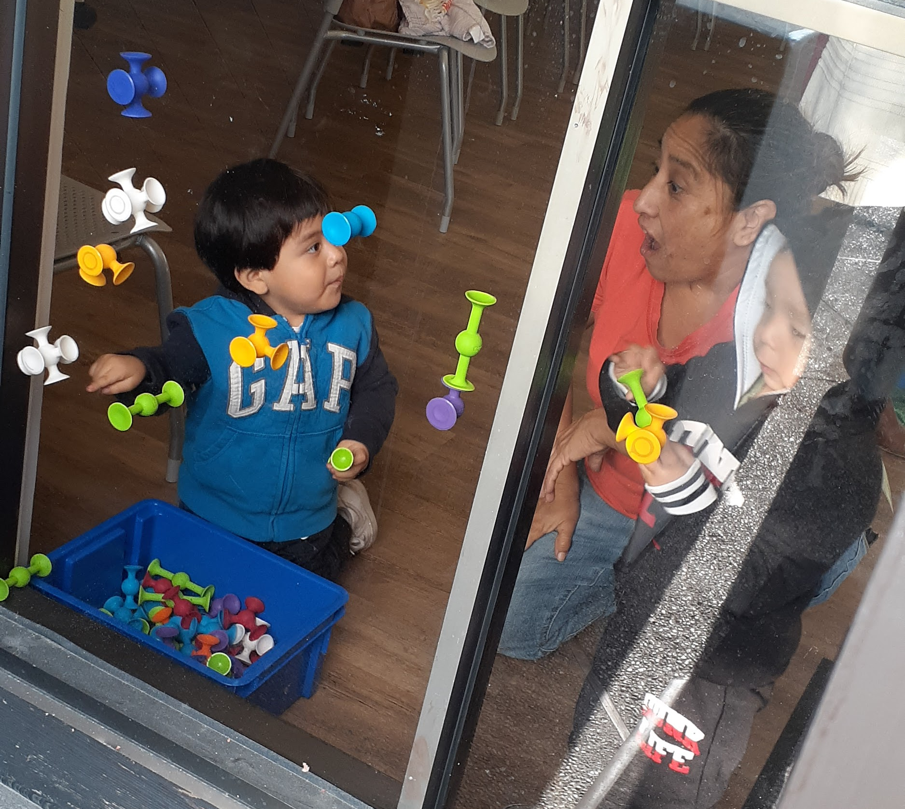
How Is Stay & Play Different
From Traditional Library Storytime?

Slide 22
How Is Stay & Play Different
From Traditional Library Storytime?
Relaxed
Free play
Outside as much as possible
Music in background
Less overwhelming for those not comfortable with a large-group, guided activity
Quiet spaces for children who needed it
Spread out over 2 Hours
Enough time to build individual connections
Caregivers could take turns staying with children and running errands

Slide 23
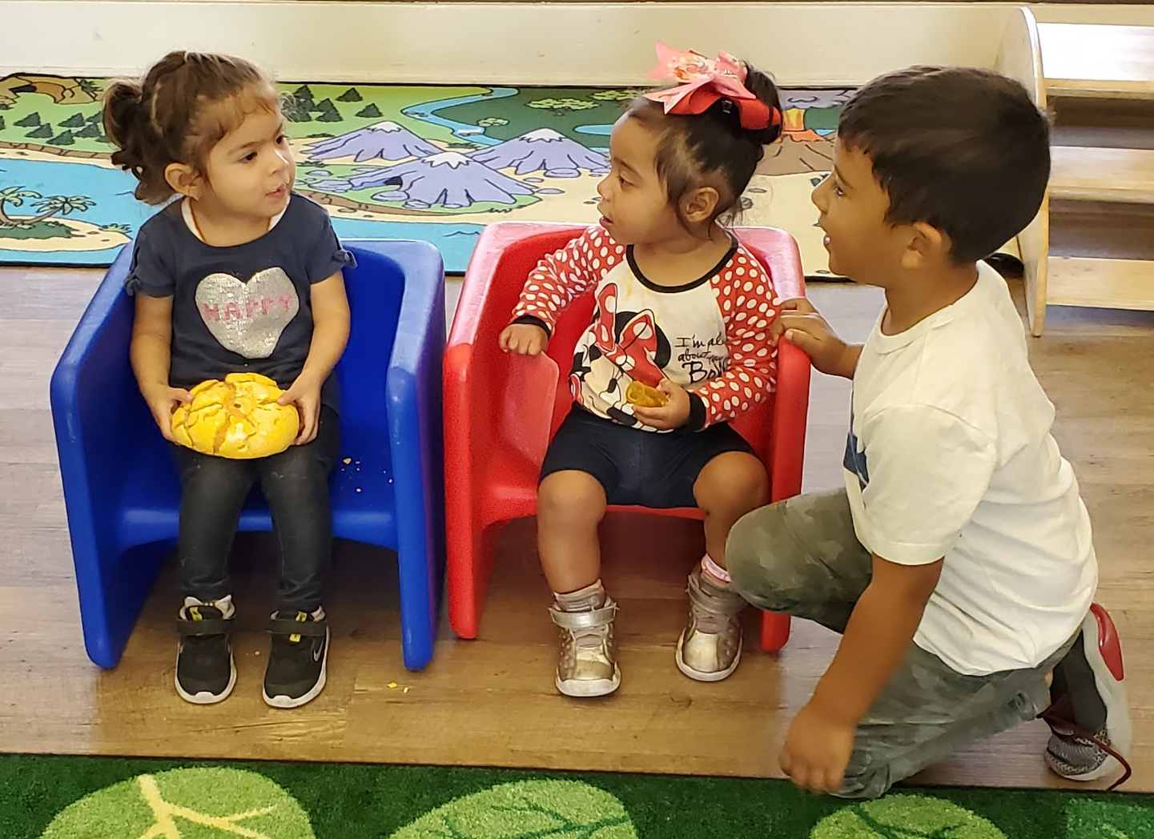
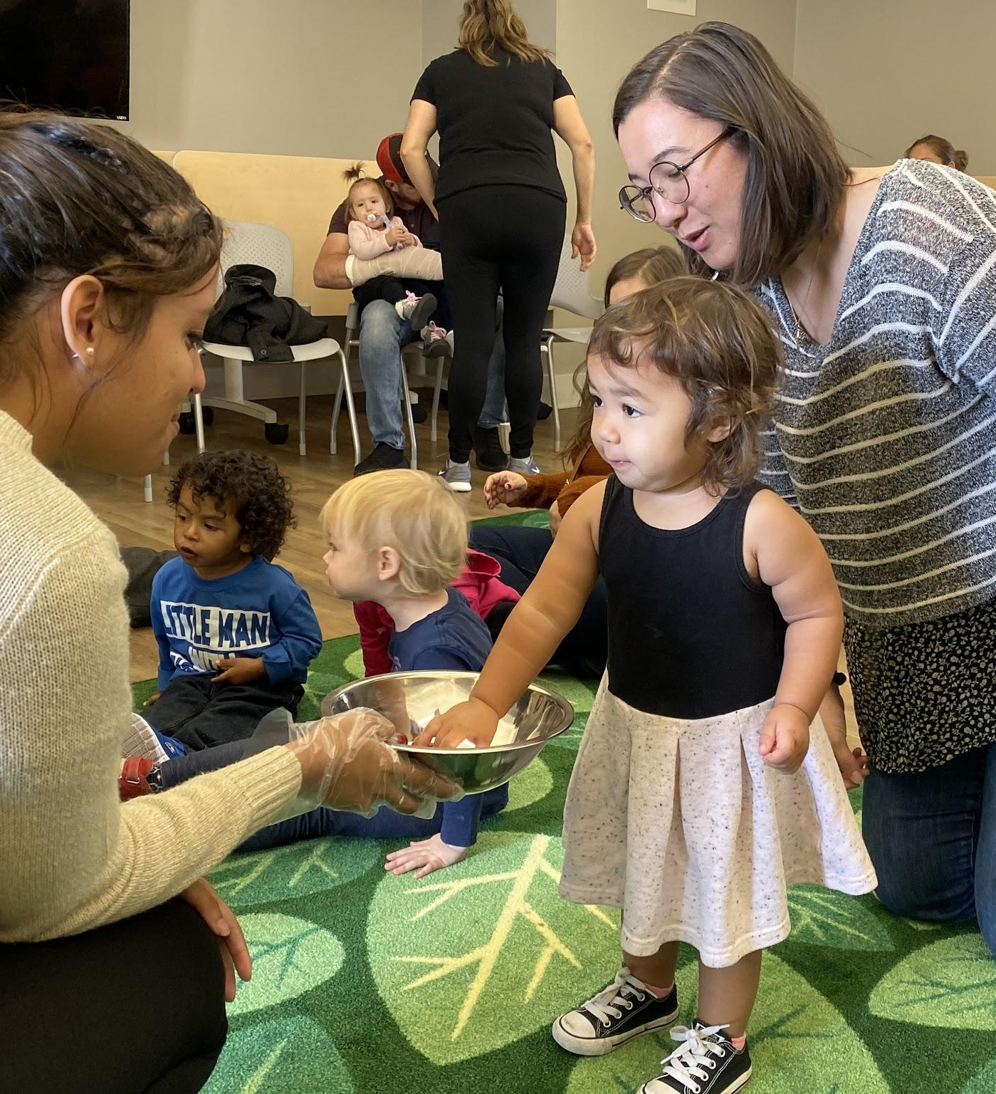
Food
Coffee for adults
Families walked over after school breakfast distribution
Snacks after storytime

Slide 24
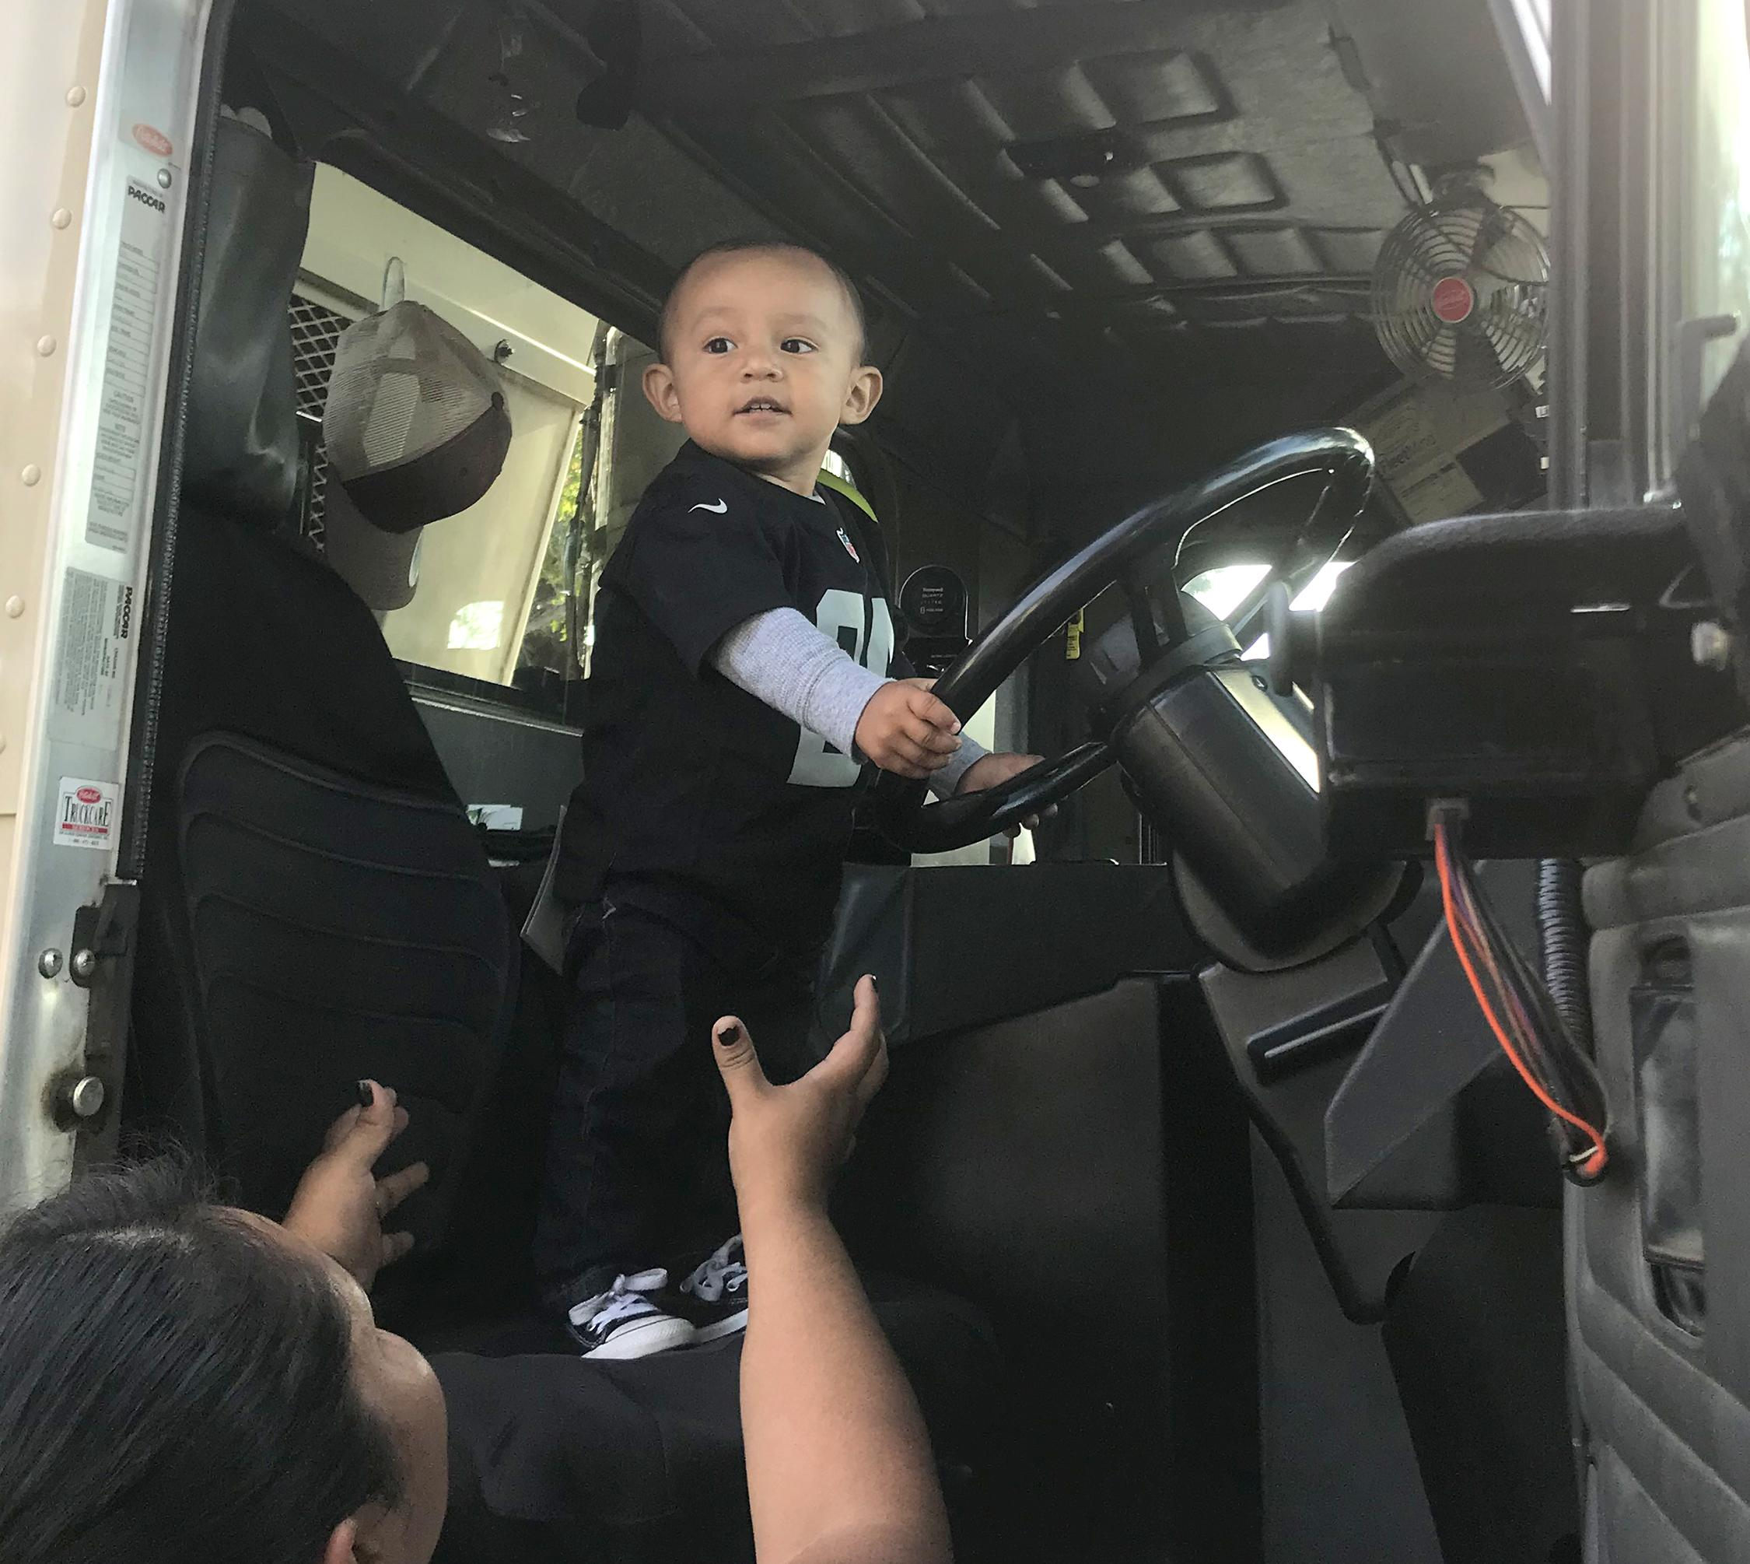
Guests
Prepared outreach specialists for a more informal group
Short presentation & then one-on-one conversations with caregivers
Participant-led invites:
Experts that could answer developmental questions from caregivers
Children engaged with garbage truck led to inviting Waste Management
FoodBank

Slide 25
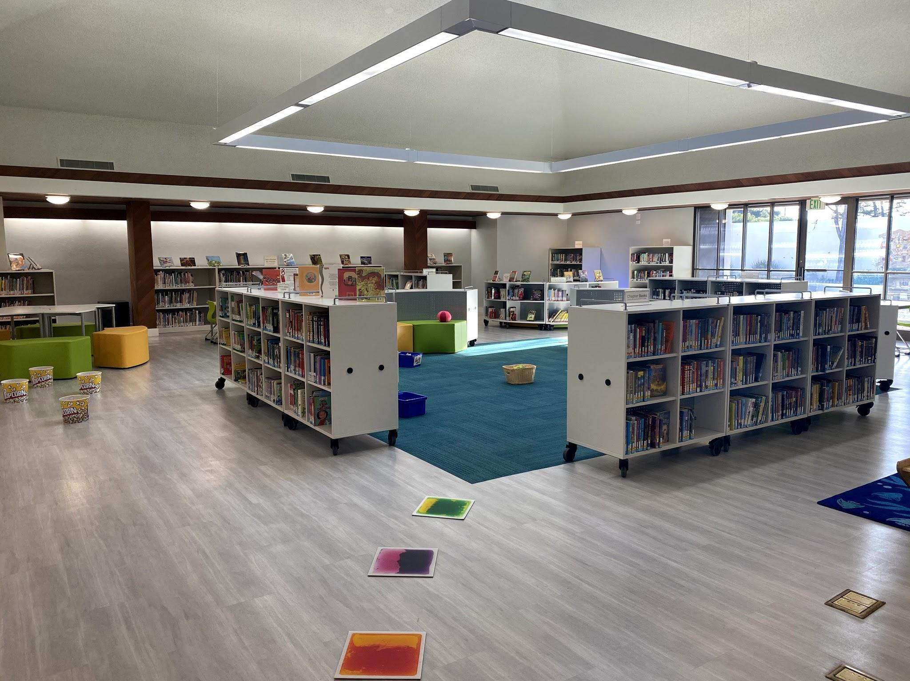
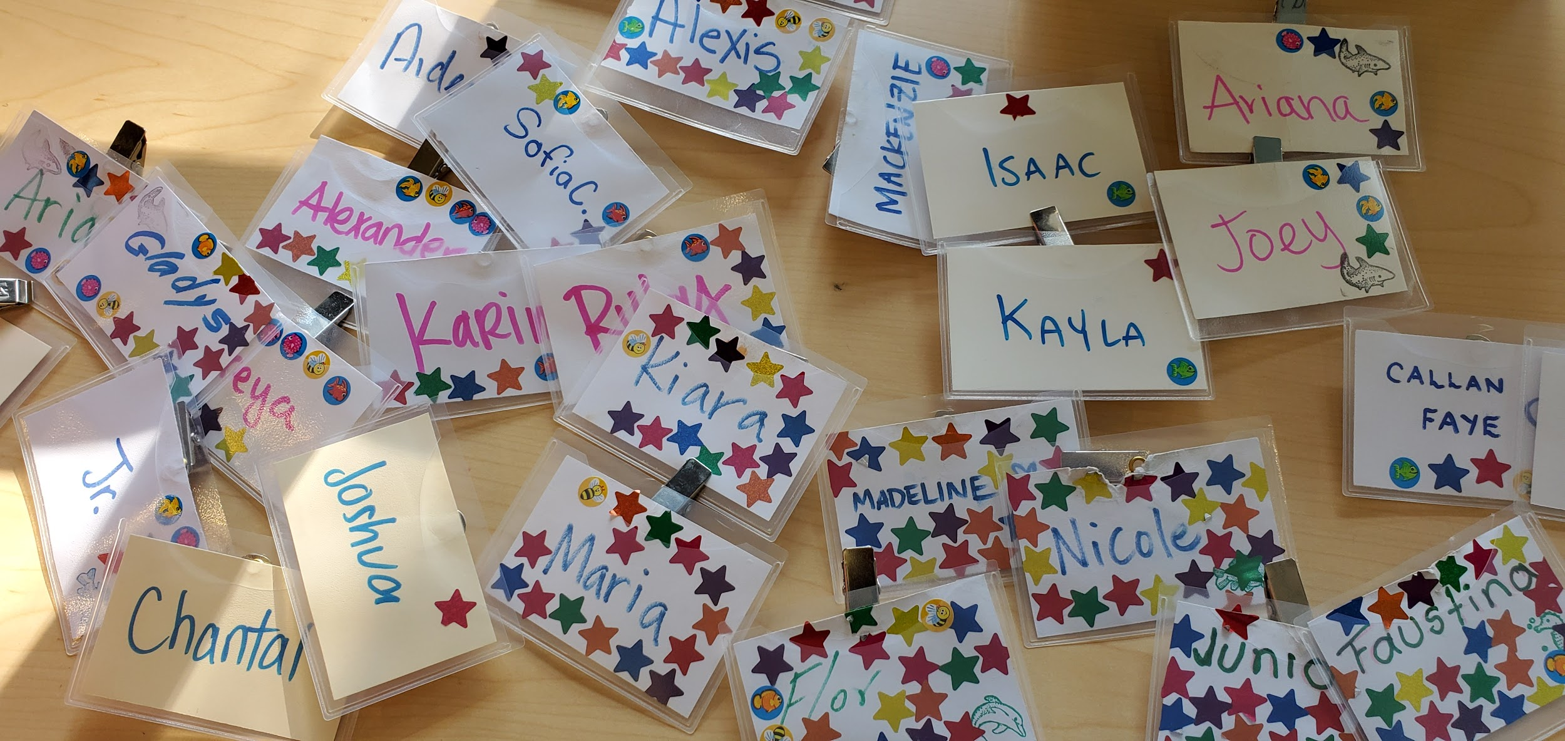
8:30 open
40 minutes free play
9:40 informal group time
40 minutes free play
Gradual “good-byes”
Familiar schedule
and room set-up

Slide 26
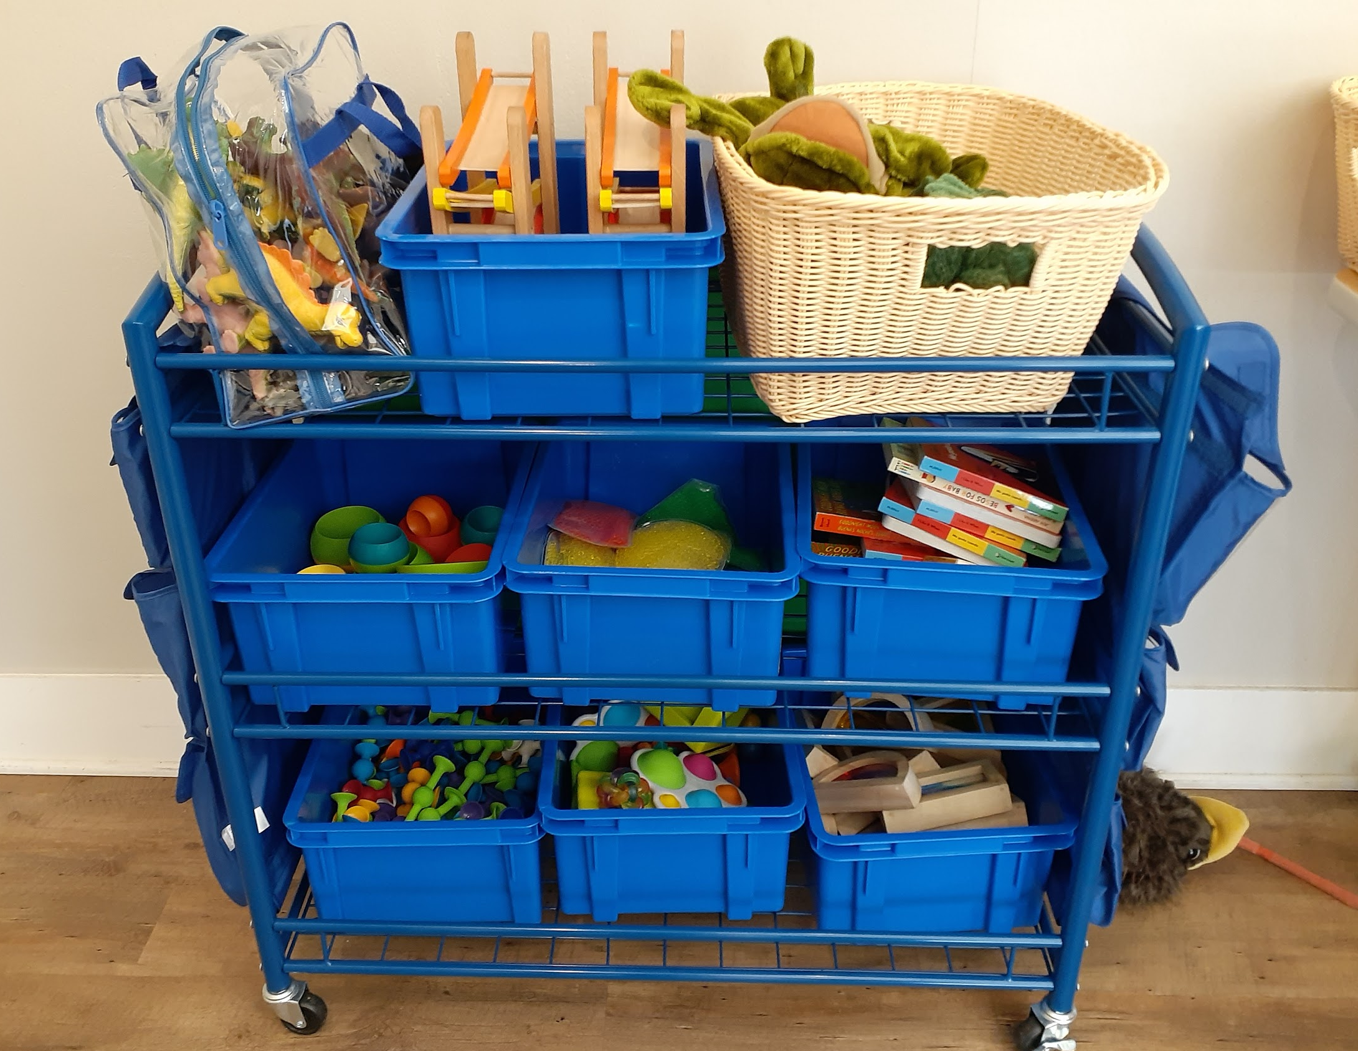
Physical Components
Movable storage
Learning toys
To-be-cleaned bin
Dishwasher

Slide 27
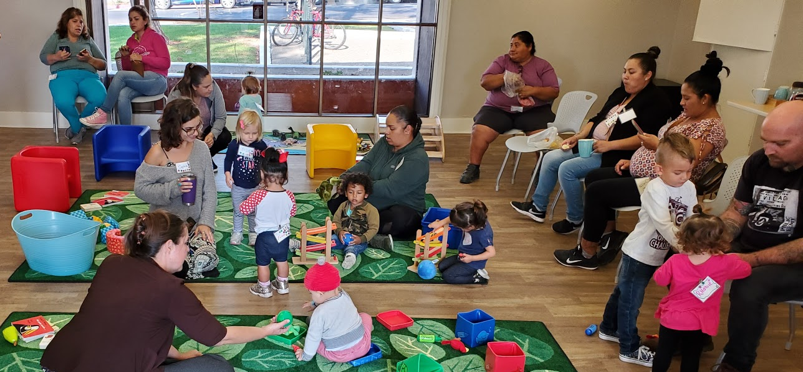
Steady attendance
Requests for more programming at the branch
High number of Spanish speakers
Caregivers sending photos of Stay & Play to child’s parents
Engaged staff
Growing numbers of caregivers with children in the Library at all times
Caregivers who had at first been reluctant to use books in the Library got Library Cards at the end of the year
Successes

Slide 28
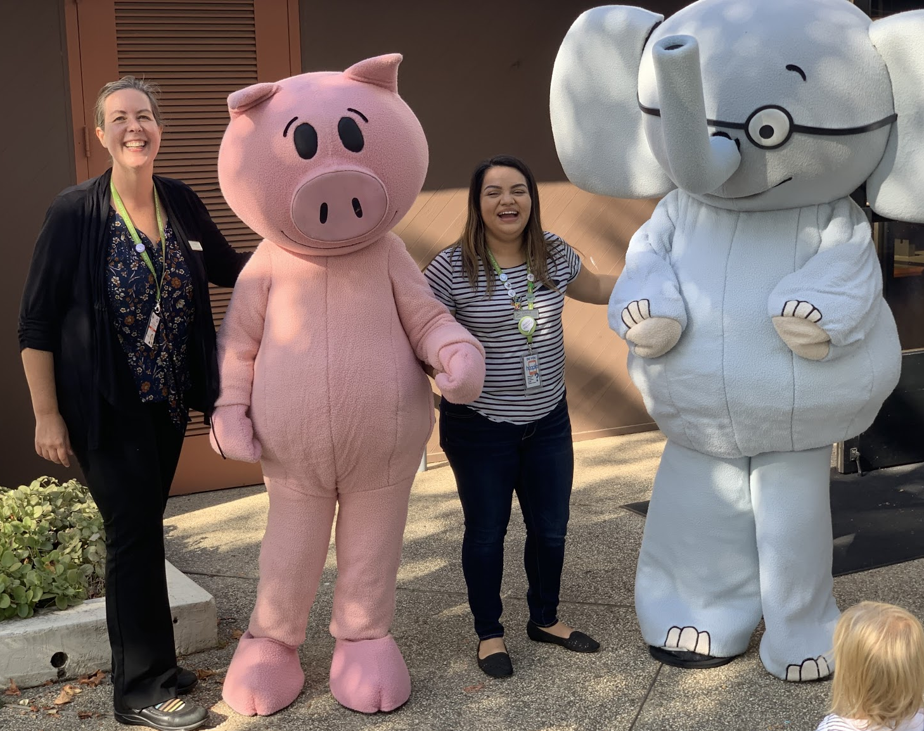
Successes
“Eastside Library Re-Opening” CityTV video on YouTube
https://www.youtube.com/watch?v=UTVtWcFDE-A
Stay & Play featured at 2 minutes; Free Play and Stories at 4:29

Slide 29
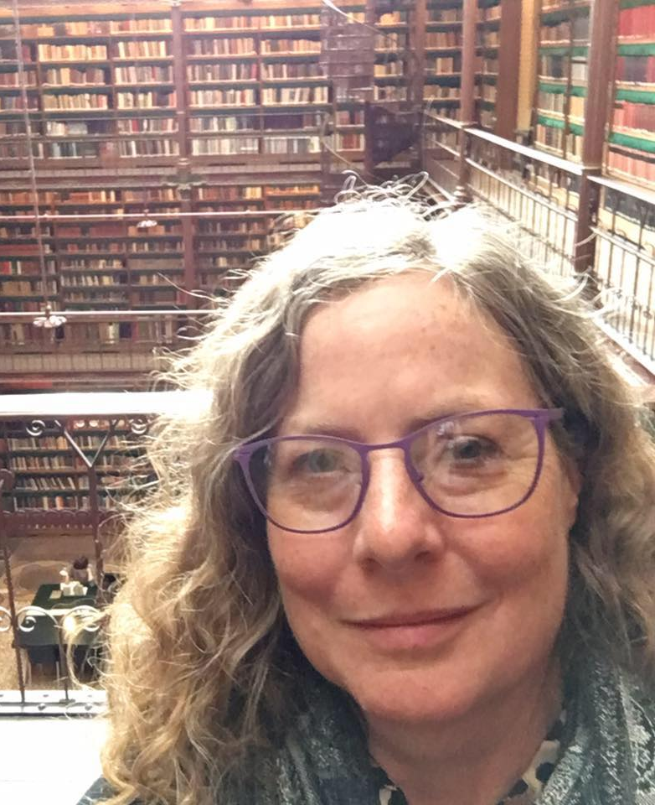
Panel Discussion:
How to maintain outreach when
in-person services are not possible
Moderator:
Barbara Bruxvoort,
Stay and Play Advisory Committee Member
Library Services Manager, San Bruno Public Library

Slide 30
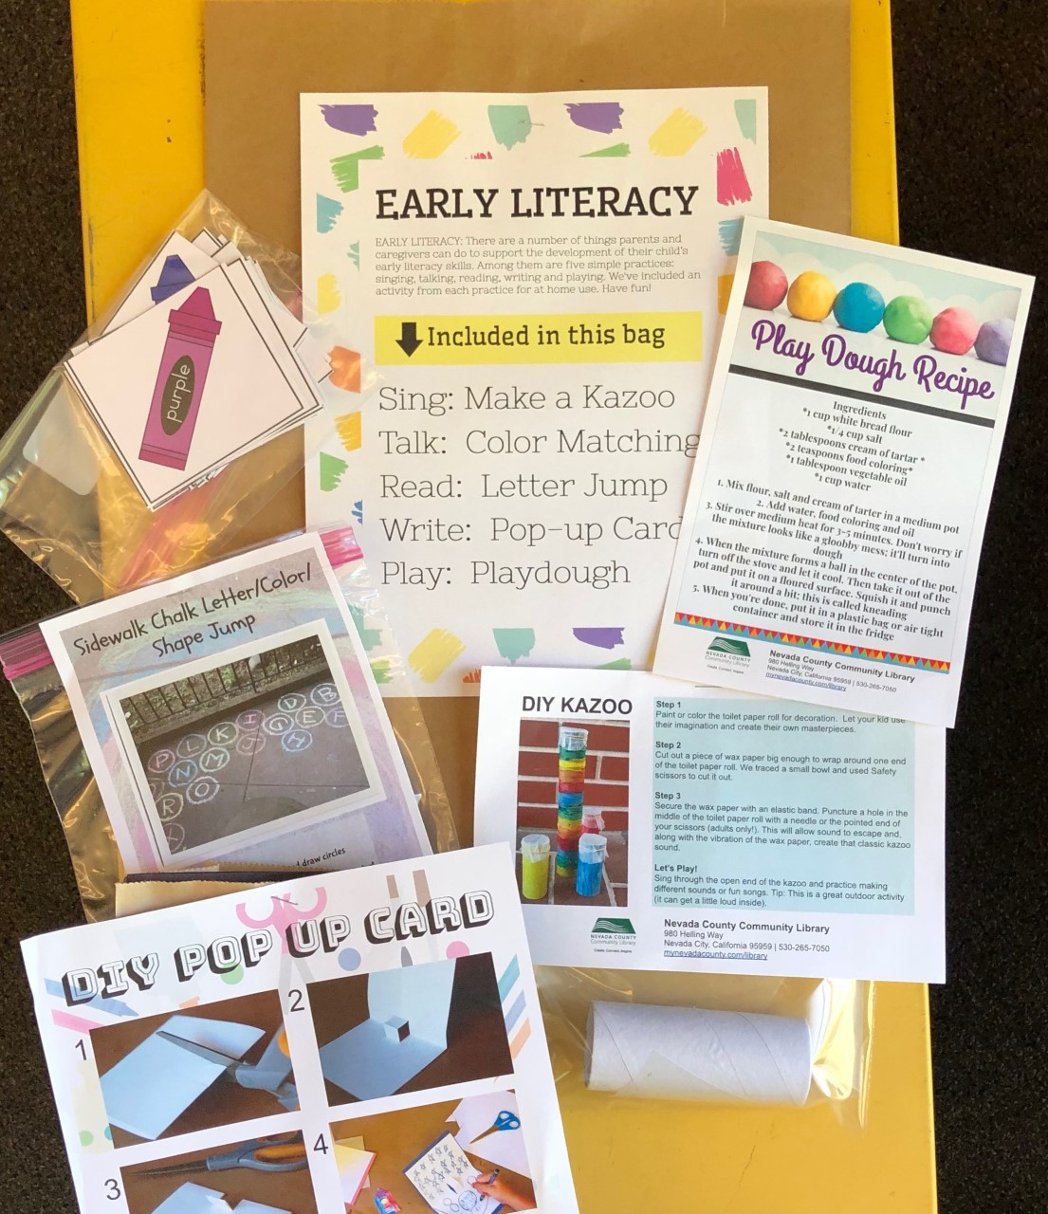
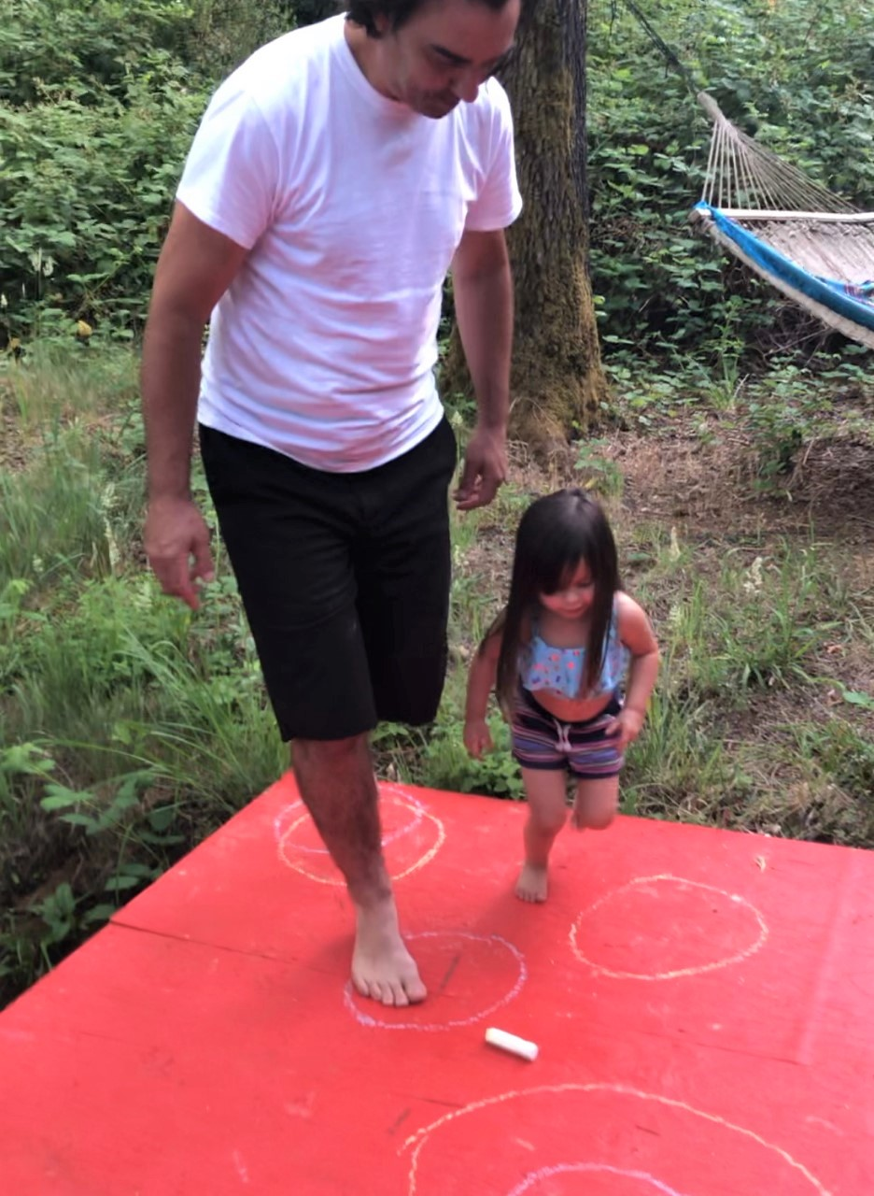
Keeping Things Active Through Covid Closures
Grab-and-Go Bags Filled with
Early Literacy Activities
Talk
Sing
Read
Write
Play
Storytime
Starter Kits
Shaky egg
Scarf
Bubbles

Slide 31
Q & A
Notes:
1:10 pass to Jody for a closing

Slide 32
This project was made possible with funding from the David and Lucile Packard Foundation and this project was supported in part by the U.S. Institute of Museum and Library Services under the provisions of the Library Services and Technology Act, administered in California by the State Librarian.
Advisory Committee Members:
Carolyn Brooks, El Dorado County Library; Barbara Bruxvoort, San Bruno Public Library; Suzanne Flint, Child Development Specialist; Kathi Guerrero, El Dorado County First 5; Margaret Jerene, Alameda County First 5; Nina Lindsay, Oakland Public Library; and Lisa Regalla, Bay Area Discovery Museum
Project Evaluation: Engage R&D
Notes:
Jody – thank everyone for joining us
Short Survey to fill out
If we’ve peaked your interest – toolkit in the fall
Hoping to scale it up and more information to come soon!

